Slide 1
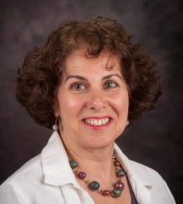
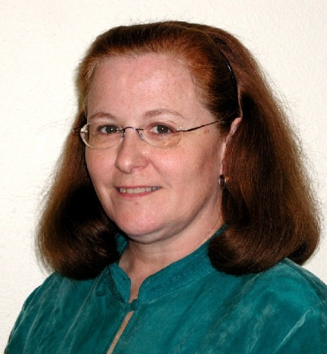
Extension’s Leadership in Health Care Reform: Preparing Families, Businesses, and Communities
Graham McCaulley, MA
Extension Associate
Personal Financial Planning Extension
University of Missouri
Roberta Riportella, Ph.D.
Kansas Health Foundation Professor of
Community Health & Extension Specialist
Kansas State University
K State Research and Extension
Mary Meehan-Strub, J.D.
Professor, Department of Family Development
Family Living Agent
UW-Extension, La Crosse County
JCEP Galaxy IV Conference
September 18, 2013

Slide 2
Why would Extension do educational programs on ACA?
Extension Perspective
Local faculty/specialists - pulse on their communities
Unbiased educational resource – responsive to local needs
Build community capacity
Empower individuals and families to make informed decisions
National issue – potential impact on everyone
-2013 -- Teachable year

Slide 3
What is happening nationally
ECOP National Task Force on Health
Goals about identifying priorities, outcome indicators, potential partners
Access to, and understanding health insurance priorities
Audiences
Consumers
Educators
Small businesses
Farmers

Slide 4
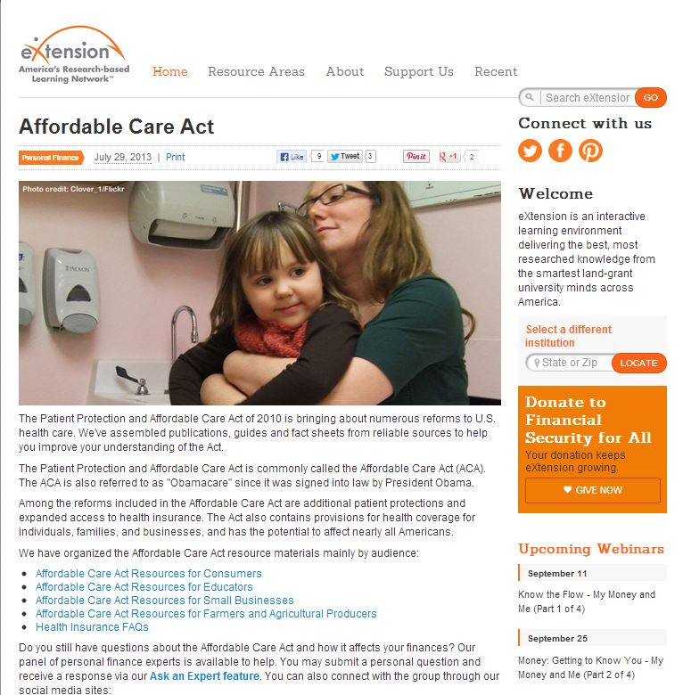
What is happening nationally: eXtension CoPs
http://www.extension.org/pages/68424/affordable-care-act#.UgFTK5K1HTo

Slide 6
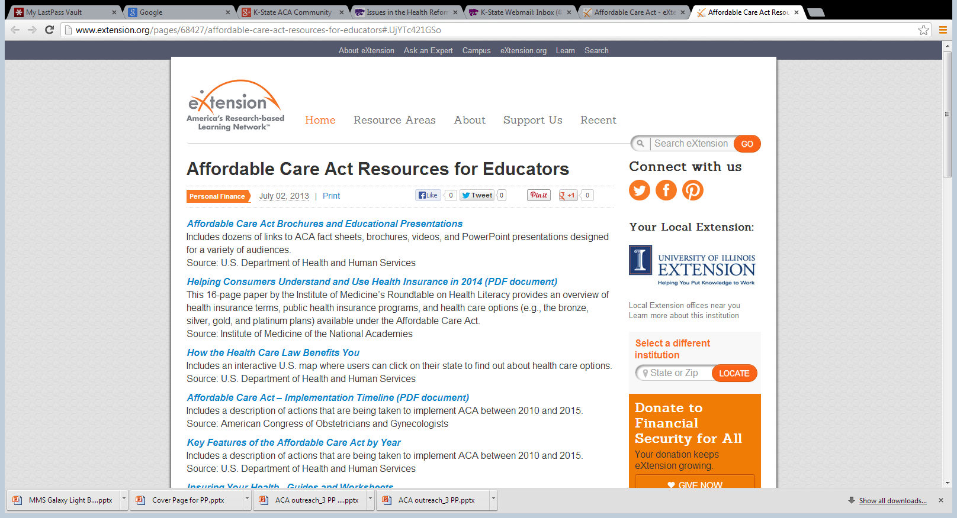

Slide 7
Goals for KSRE ACA Educational Programming
Prepare all county and state based faculty with knowledge about ACA sufficient to be conversant in their communities about what ACA means for consumers and their communities
Prepare selected county and state based faculty to participate more directly in community education (consumers, small businesses)
how ACA works, what to expect, etc.
NOT necessarily to help with enrollment in plans but some may
Likely involvement in health insurance literacy education

Slide 8
Methods and Actors
Methods
Trainings
District Trainings
Statewide Trainings
Emails, blog, google community
Development of support materials
Partnering with Consortium for Navigator proposal
Partnering with state foundations and others doing education
Actors
State specialists led by Roberta Riportella
Health care reform ad hoc work team
County based faculty
Support from KSRE Administration
National partners

Slide 9
KSRE Health Reform Ad Hoc Team
Roberta Riportella, College of Human Ecology
Cindy Evans, FCS Shawnee County
Sharolyn Fleming Jackson, FCS Specialist
Elaine Johannes, College of Human Ecology
Joan Kahl, College of Human Ecology
Elizabeth Kiss, College of Human Ecology
Susie Latta, FCS Marshall County
Lisa Martin, EFNEP Shawnee County
Trudy Rice, Community Development Specialist
Debra Wood, FCS Central Kansas District
NEW: University of Kansas Medical Center, Family Medicine

Slide 10
What’s been done
National eXtension webinars
Website repository of materials
Blog
County Fairs poster boards, factsheets (almost half counties)
State Fair

Slide 11
What’s been done: cont’d.
Several community presentations
Presentation to advisory group to gain local support
Media
Press releases
Magazine articles
Video
Radio shows
Interviews
Internally
5 area wide county faculty trainings, 1 statewide (n = ~150)
Public issues education justification piece by Associate Director, program director, state specialist

Slide 12
http://ksre.ksu.edu/issuesinhealthreform/p.aspx?tabid=18

Slide 13
http://ksre.ksu.edu/issuesinhealthreform/p.aspx?tabid=19

Slide 14
http://ksre.ksu.edu/issuesinhealthreform/p.aspx?tabid=21

Slide 15
Fact Sheets
What impact will ACA have on Kansans?
What is the 'Marketplace?'
How are small businesses (farms) and rural communities affected?
What's next for health care reform in Kansas?

Slide 16
Factsheets Under Development
ACA Facts: Protect Yourself from Scams and Fraud
How do I get health insurance?

Slide 17
http://ksre.ksu.edu/issuesinhealthreform/p.aspx?tabid=17

Slide 18
https://blogs.ksre.ksu.edu/issuesinhealthreform/

Slide 19
K-State ACA Community (google+)

Slide 20
What’s next
Leader guide for community presentations
Collaboration around Navigator grant
Farm Families and ACA
Health Insurance Literacy

Slide 21
You and Health Insurance: Making a Smart Choice for Farm Families
Insert University
Extension Logo
Prepared by Barbara O’Neill, Rutgers University, and Roberta Riportella, Kansas State University
Notes:
Thank you for attending this program about making a Smart Choice for Health Insurance. It is a part of a multi-state Cooperative Extension effort to help you better understand your health insurance choices and make the best decisions for you and your family.
This presentation includes information about the two ways that the Affordable Care Act (ACA) affects farm families: 1) As individual consumers of health insurance just like other Americans and 2) As employers of farm workers. Key provisions of the ACA law are described along with examples of how they affect farm families.
Insert University Extension Logo

Slide 22
What is it?
Smart Choice for Health Insurance is an entrepreneurial, comprehensive, research-based, unbiased curriculum designed by a team of experts led by the University of Maryland Extension. Its purpose is to equip consumers with tools they need to make the best possible decision when choosing health insurance plans for themselves and their families.
When will Smart Choice be available?
Workshops for consumers will take place around the country beginning in October 2013.
Where can I find more information?
Contact Bonnie Braun, bbraun@umd.edu
For additional information or to Ask an Expert questions or to questions and answers, go to extension.umd.edu/insure
Notes:
Insert University Extension Logo

Slide 23
Roberta Riportella, Ph.D. Kansas Health Foundation Professor of Community Health
School of Family Studies and Human Services
College of Human Ecology
Kansas State University
K-State Research and Extension
343 Justin Hall
Manhattan, KS 66506
785-532-1942
rriporte@k-state.edu
@rriporte
Emerita Professor
School of Human Ecology
University of Wisconsin-Madison

Slide 24
University of Missouri Extension Health Insurance Education Initiative
Graham McCaulley
Molly Vetter-Smith
Brenda Procter
Notes:
My name is Graham McCaulley and I am an Extension Associate with University of Missouri Human Environmental Sciences Extension. I’m here to talk about the work University of Missouri Extension is doing around health insurance and ACA implementation. I’m on the leadership team for this initiative along with Brenda Procter and Molly Vetter-Smith, and Molly was originally set to present today but we just rolled out our initiative and so the other team members are attending extension faculty trainings around the state this week.
I’d like to present how we are doing this work in Missouri through a cross-program initiative, sort of as a case study. We have been working heavily on this project for about 6 months, and have discovered that developing this initiative will always be a work in progress- that’s the nature of the law (it’s kind of a moving target) and that’s the nature of this work, Also, we really want to work collaboratively with field faculty, which will continue to affect our curriculum and programming, as when they report something may work better a different way, we’ll reflect that in the curriculum.

Slide 25
The Initiative
Project goal:
Lead a statewide educational initiative to ensure that all Missourians have the resources and skills they need to make informed health insurance decisions for themselves, their families, and their businesses
Extension will provide the facts to help participants:
Better understand the law and clear up confusion
Understand health insurance options
Make informed health insurance decisions
Notes:
Background / Need
So we know the ACA is the most influential health-policy law passed by Congress since Medicare, and we know there has been debate and speculation over the last 3 years that has caused confusion. For example, a recent survey found 42% of the public were unaware the ACA was law, while 12% believed that law had been repealed.
Whether one feels positively or negatively towards the ACA, the fact is that it is law and it is being implemented. We know Missourians have not been adequately informed about the law, and are not prepared to make educated health insurance decisions when the Health Insurance Marketplace starts up, as well as when the individual mandate for health insurance coverage takes effect.
Why MU Extension
MU Extension is involved in this educational initiative because we are viewed as a reliable, nonpartisan entity. Our regional extension specialists are in place and available to provide local educational programming on this politically charged issue. They have trust of their communities and the local connection to their unique audiences, county councils and community networks, and in the past they have successfully educated Missourians on other politically controversial topic.
Our initiative
We requested support for this cross-program initiative from all MU Extension program areas, at all levels, as well as from extension councils. Although the focus of this initiative may have felt unfamiliar or extraneous to some regional specialists who have other programming responsibilities, we know that this work fits into the new era of program integration.
By mobilizing resources from all program areas we can respond to constituents’ questions, dispel myths, provide facts, and help our constituents — individuals, families, farmers, businesses, nonprofits, health care professionals, and community leaders — better understand the law and make informed health insurance decisions.

Slide 26
Individuals and Families Curriculum
Health insurance/ACA basics
Coverage and payment options for individuals
and families
Additional information for sub-groups
Information on employer-based insurance
Information about Medicare
Notes:
Section 1
Health Insurance Basics- this section covers:
How the Affordable Care Act has changed health insurance laws and how this may affect participants
Why health insurance is important, and
Basic health insurance terms participants need to understand.
Section 2
Coverage and payment options for individuals and families-
This section discusses options for getting health insurance coverage and details about Missouri’s Health Insurance Marketplace.
Since the marketplace is a new resource that many may not know about, we do focus a considerable amount on it, including how the Marketplace works, including types of plans, premium tax credits and cost-sharing discounts, and how to get enrollment assistance.
We also cover the range of health insurance options, including employer-sponsored insurance, Private insurance (or direct purchase insurance), Medicare, Medicaid, and other options such as military or Indian health insurance.
It was important for us to cover the full range of health insurance options, as our initiative's goal is educational and for Missourian’s to have all the information they need to make an informed decision. We put forth the benefits of health insurance, but also provide information on the individual mandate and the decision to not obtain health insurance.
These first two sections are our core curriculum, and serve to provide basic health insurance literacy, information on the ACA, and the range of health insurance options. The following three sections may be presented along with the core curriculum if Extension faculty are leading a day-long workshop, they could be standalone pieces, or they may be pulled from to integrate into the core curriculum.
Section 3
Our third section provides supplemental information for specific groups, as there are certain aspects of the ACA that specific groups of people need to be particularly aware of. This section provides information for seniors, near-retirees, women, young adults, college students, veterans and military families, immigrants, and LGBT individuals
Section 4
This section provides information on employer-based insurance with a focus of the options for employees of various sized businesses. This could be a stand alone piece, for example, if Extension faculty were presenting to employer groups or part of workforce development programming.
Section 5
Our final section is focused on Medicare, mainly explaining how it works and how it is affected by the ACA. We are funded, in part, by the Missouri Foundation for Health, which has been doing ACA information workshops for the last 3 years, and one of the things they told us was that at many presentations noticed little old ladies on front row...
Even if full curriculum is never presented as such, was key for training staff, struggled with how much info to put in slides vs. speaker notes

Slide 27
Context for the Initiative
Initiative stems from new strategic plan, part of which aims to “build a culture of One MU Extension”
Program integration:
A structured approach to interdisciplinary work…enabling existing MU Extension units to collaborate with each other and external organizations in flexible, dynamic and fluid ways
Notes:
One big reason our initiative has moved forward is that we were be able to convince extension administration all the way to the top that we all needed to do this. At our last annual conference a guiding theme was “program integration” and we received strong messages on the importance of programming:
with broad relevance that would naturally fit with different program areas
projects that had economic impact and the potential to generate revenue, and
projects that could bring together all areas of extension that would showcase the power of the whole organization and make it more obvious to the public what extension is about and how powerful it is when called on to respond to new needs
Our initiative was the first program to be proposed under our new program integration model, which emerged from our Extension system’s strategic plan to Build a culture of “One MU Extension” by integrating all programs and services, both on and off campus, while valuing unique strengths.
This program integration model has allowed us to have support from the top down in Extension (from vice provost down) from the start of the project. This has also led to an intentional, structured approach to doing this across all program areas statewide. Roberta spoke on how this is relevant to most all Extension program areas, and we have found this to be the case as well and the rationale behind our cross-program approach.
One issue with working across program areas is varying levels of support across program areas. We’ve discovered it takes leadership from program leaders to make this work, and some provide more leadership than others. But it helps to have these messages of leadership from the top down.
Field faculty are used to working across program areas, although not always so much on state level. We have had to work quickly on this initiative because of the timeline that’s been imposed on ACA implementation, and we regretted we couldn’t involve our state/campus based colleagues from other disciplines as fully as we would have liked from the start. However, we have put together a model that allows for leadership across programs….
Program integration is a structured approach to interdisciplinary work using five new theme areas and teams:
Educational attainment; Environmental concerns; Community, economic, business and workforce development; Global food systems; Health systems
Each of these theme areas will be based on MU Extension expertise and will be integrated with:
Banner outcomes; Development priorities; National Institute of Food and Agriculture (NIFA); Mizzou Advantage
Program integration will
align programming into a systems framework;
expand the interdisciplinary approach for program development and delivery;
increase flexibility for MU Extension’s response to complex issues;
develop the ability to move resources quickly, based upon program needs;
connect MU Extension to the larger MU network, NIFA and other partners;
deliver time-limited programming that is measurable and accountable; and
innovate and collaborate in developing research-based solutions that best serve Missouri citizens.
Program theme areas are not newly created extension units or operational areas. Instead, program theme areas are structured, interdisciplinary methods that enable existing MU Extension units to collaborate with each other and external organizations in flexible, dynamic and fluid ways. Following are MU Extension’s program theme areas, accompanied by examples that show how program theme areas can cross over the traditional extension organizational structure.
Health systems: Improve individual, family and community health.
(http://extension.missouri.edu/staff/what-is-program-integration.aspx)

Slide 28
Structure of the Initiative
Program Integration Team
Extension Leadership
Core Leadership Team for this Initiative
State Level Team for this Initiative
Regional Team Leaders
Urban Region
MU Extension Communication Team
NW Region
SE Region
NE Region
East Central Region
West Central Region
SW Region
Notes:
So here’s how we’ve structured our initiative, and this approach was in place from the start.
Extension leadership- Extension vice provost, asst. vice provost, and other administrators. Have been supportive since day one bc part of program integration focus, but also because this initiative fits the mission of extension- in Missouri we are one of the only ones out there providing unbiased, fact-based information on an important, timely topic. We are being responsive to a strong need in our state, and when leadership recognizes this it helps with getting other extension faculty on board.
State level team- State specialists provide support with their program areas and any unique aspects of their audiences. University of Missouri Extension is unique in that part of our programming areas include (list all areas on board)- find list
Regional team leaders- these are masters level faculty doing programming across the state. All of the people on this team were volunteers, as were the regional teams
Regional teams- about 2/3 of our faculty have stepped up to join the initiative
Every region has team members from every program area. Teams are about 8-12 people.
Communications- web support, marketing support, editing, video- basically all media, publication support.
Process:
We, as the core leadership team, develop curriculum and logistics
We receive support (such as legal or communications guidance) from our leadership and campus-based partners.
We also consult with the state level team and train the regional team leaders,
who then train the rest of their team to do programming.
We are also training support staff and non-programming staff on the importance of political neutrality and how to manage sticky situations, which leads me to the some comments on our political context and protocols we’ve developed…

Slide 29
Political Considerations
Trainings
“Train-the-trainer” model using leadership team
Political neutrality training for regional frontline staff and
non-programming faculty
Media and public comment protocol
Curriculum review
Notes:
Because of the political climate around doing any education related to the Affordable Care Act, we are taking, and have since the start taken, a very cautious, sensitive, and planned approach to staying politically neutral.
Trainings
All of this has been in place since well before we went public, and we have stressed this in our trainings. Our training model involves the core leadership team and campus partners training the regional leadership team. After this train the trainer training they hold trainings in their region, which we attend as requested.
At these trainings faculty go through ACA political neutrality role plays and go over our process for handling inquiries. We have also developed a training for frontline staff and nonprograming faculty that we will do over adobe sessions, which again stresses talking points, neutrality, and our strict protocols
Process for handling problems/inquiries:
When an inquiry occurs at the field staff or faculty level, our personnel use the talking points and refer the call to our core leadership team.
If the inquiry is from a member of the media, we attempt to respond with a call or email in two hours if possible.
If the call is from the general public, we use a 12 to 24 hour window
Our approach is for transparency with media, legislators and key stakeholders, and not engaging in any support or dislike for the ACA, no matter who we are communicating with. We have calls directed to us so that our message stays consistent and accurate about our educational role.
Curriculum review- Only the core leadership team creates curriculum and has a heavy criteria for neutral, fact-based sources… and even then we continue to removing any hint of bias (for example, some could consider healthcare.gov…)
Further review of curriculum has involved :
Communications and Extension public relations review
The MU system government relations team review, as well as our system attorney
Finally, we vet our curriculum for accuracy through staff from the Missouri Foundation for Health, who is our partner who is leading a parallel education initiative in our state…they also check accuracy and neutrality.
And then after all these reviews we usually need to update, as some aspect of the law’s implementation probably changed

Slide 30
Disclaimer statement
MU Extension has provided this information to help Missouri residents make informed health insurance decisions by understanding options and responsibilities outlined in the Affordable Care Act. MU Extension provides factual information on public policies such as the ACA.
Notes:
This is the disclaimer statement that we have on all publications related to our initiative. We have had to be very cautious and intentional about everything we are doing, and our political neutrality training has been informed by some unique aspects of our state. For example, a ballot measure was passed last November that
Prop E
Prohibits state employees from establishing, administering or operating a state-based or federal based health exchange. It also prohibits them from assisting the federal government’s creation or operation of such a facility.
So we’ve had to be sure our efforts can not be interpreted as anything other than providing information for people to make their own decisions with. And we’ve had to be sensitive to making sure this information cannot be interpreted as supporting the implementation of the marketplace…so if we provide contact information for navigators, we also provide contact information for insurance agents and brokers as an option as well, and we stress that people should make whatever they feel the best choice for them is.

Slide 31
Molly Vetter-Smith PhD, MPH, RD
State Specialist for Health Education
573-882-4107
vettersmithm@health.missouri.edu
Brenda Procter, M.S. Extension Associate Professor 573-882-3820
procterb@missouri.edu
Graham McCaulley, MA Extension Associate, Human Environmental Sciences Extension
573-882-2005
mccaulleyg@missouri.edu
Notes:
Our curriculum is completed and is for sale, and will have a process to provide regular updates to our curriculums to those that have purchased it. This would also include our political sensitivity training pieces.
We are a federal exchange state and our curriculum is grounded in MO, and we have yet to come up with a price, but if you are interested please contact any one of our leadership team.
And please contact us with any general questions, we’d be happy to share what has worked and hasn’t worked as well. Thank you

Slide 32
UW-Extension
and the
Affordable Care Act

Slide 33
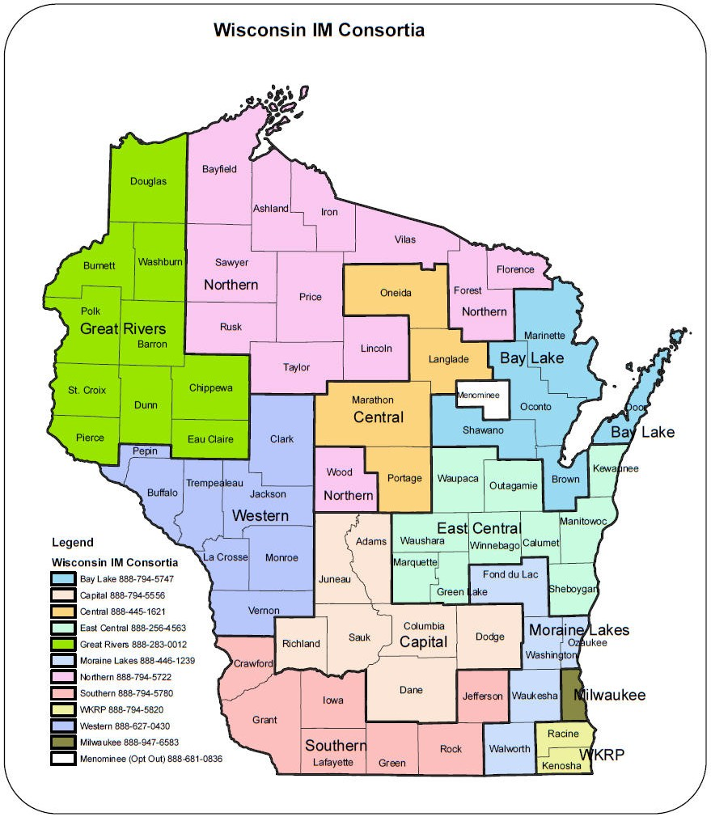
http://www.dhs.wisconsin.gov/ForwardHealth/imagency/

Slide 34
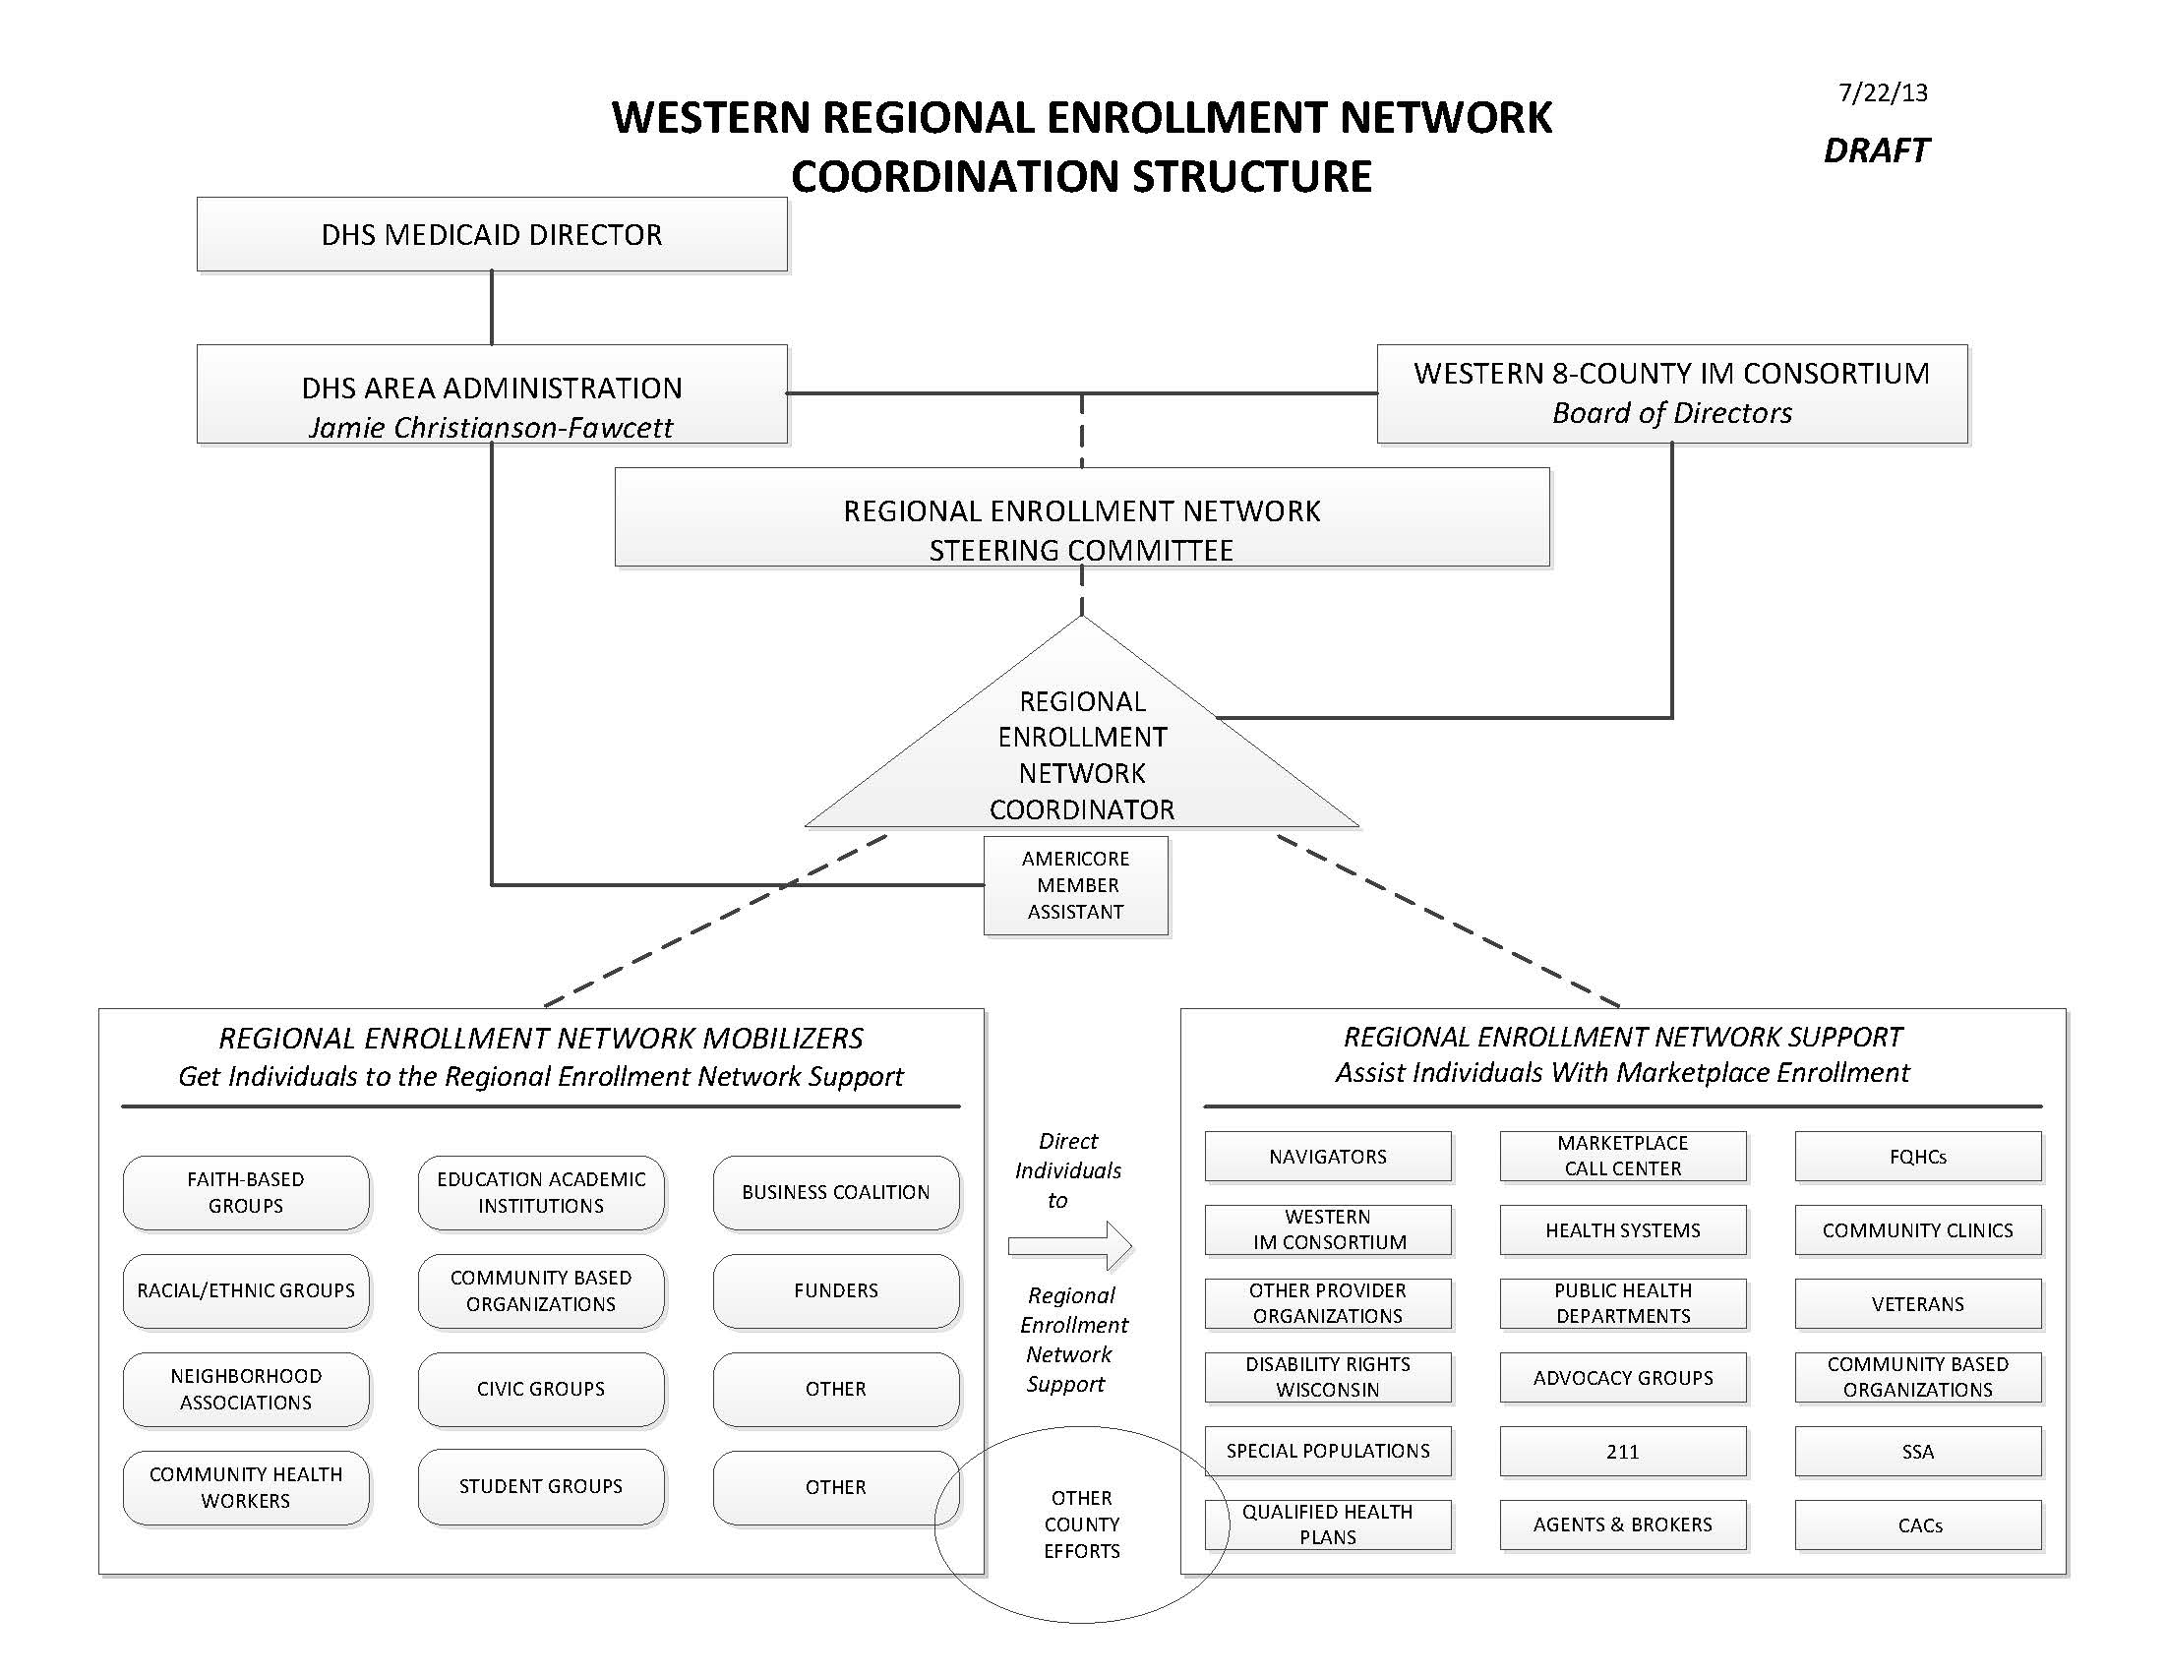

Slide 35
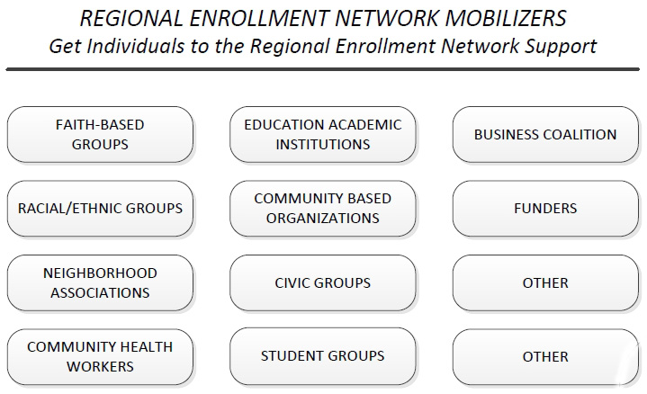

Slide 36
Extension Goals in Creating Health
Building comprehensive systems approach to helping individuals, families & communities create health.
Build Community Capacity through partnerships & collaborations.
Education for Professionals, Businesses, Consumers.

Slide 37
Extension Roles Traditional – New Traditional
Education
Organizational Development
Leadership Development
Volunteer Development
Facilitation
Convener
Mobilizer

Slide 38
What’s Happening in Wisconsin
County/Regions
General Information Programs about ACA
Regional Enrollment Network Kick-Off – Each Region
Statewide
Workshops for Extension Educators-all Program Areas
Invitation to work with RENS
On-Going
Media Resources
Health Literacy Tools
Webinars – Health Literacy
Consumers

Slide 39
https://www.ckfwi.org/affordablecareacthome.html

Slide 40
Covering Kids and Family
Fact sheets and resources can be found on the new CKF Affordable Care Act Webpage!
http://www.ckfwi.org/affordablecareact home.html

Slide 41
Resources
For up-to-date ACA information see our ACA blog:
http://ckfwiaca.wordpress.com/
And follow us on Facebook:
https://www.facebook.com/ckfwi

Slide 42
Questions ? ? ?

