Slide 1

Health Reform
Patient Protection
and Affordable Care Act
The Affordable Care Act: An Overview
Roberta Riportella, Ph.D.
Kansas Health Foundation Professor of Community Health
Kansas State University
Kansas State Research and Extension
rriporte@ksu.edu

Slide 2

Understand how ACA is poised to change the health care landscape
Understand the why’s and what’s of health care reform
Share examples of Extensions’ responses
Share resources
Address unanswered questions acknowledging this is a moving target

Slide 3
How Do We Create Health?
Health
Insurance
Wellness
Health Care
Environmental
Factors
Occupational
Factors
Emotional and
Mental Health
Lifestyle Choices
(Diet, Exercise)
Notes:
3
As we begin our discussion, it’s important to keep in mind that health insurance coverage, as a potential means of health care access, is only one factor in one’s overall wellness.

Slide 4


Driven by concerns with costs and quality of, and access to care, ACA is set to change
  How health is created with
    A balance of personal and social responsibilities
    A balance between the medical care system and other actors
    A focus on prevention and primary care
  How health care is delivered and by whom
  How health care is paid for and how much
  How private insurance is purchased (for many)
    And its new minimum standards
  How the public insurance systems work
  So much more than health insurance reform
Notes:
Transformative
Ambitious
Crazy
Hated
Loved
Dictatorial

Slide 5
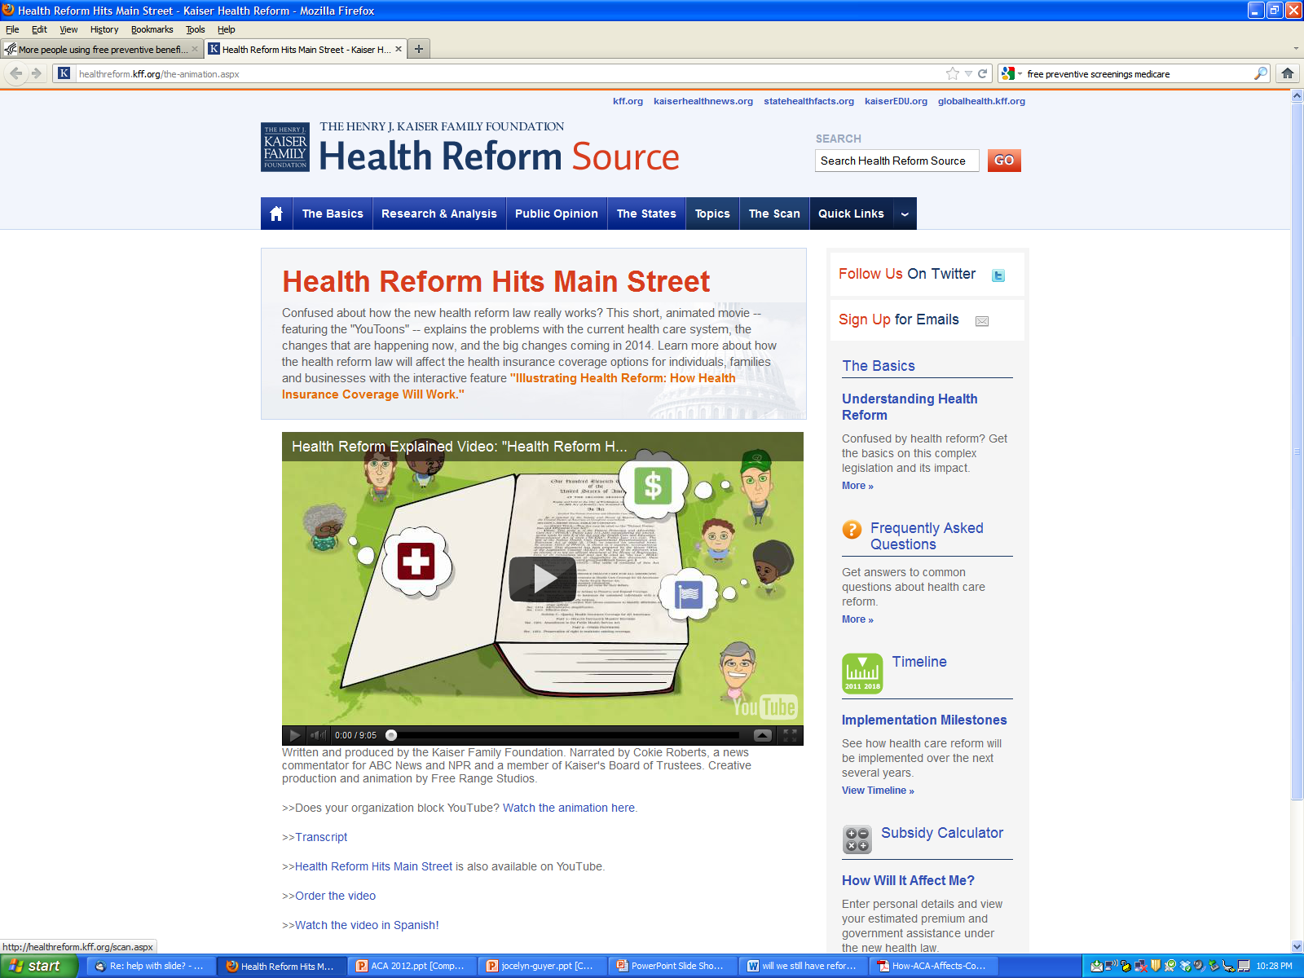

Slide 6
Why do we need health reform?
Costs, Quality, Access
Costs: Excessive
Quality: Inconsistent
  Disparities
  Patients often don’t receive recommended care
Access: Inadequate
  Millions underinsured or uninsured or one major illness away from being uninsured
  The right health care providers close by

Slide 7

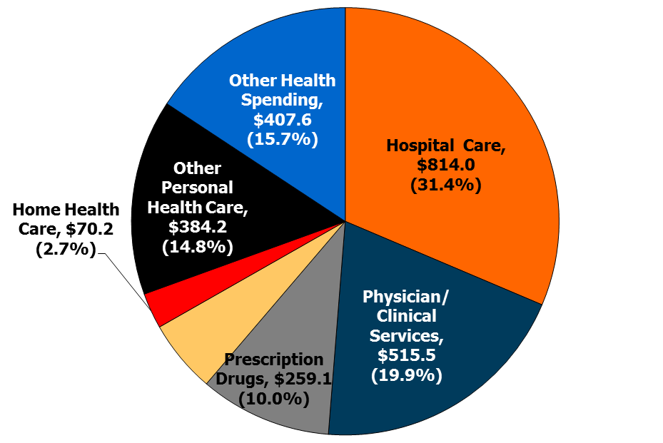
Distribution of National Health Expenditures, by Type of Service (in Billions), 2010
Nursing Care Facilities & Continuing Care Retirement Communities, $143.1 (5.5%)
NHE Total Expenditures: $2,593.6 billion
Note: Other Personal Health Care includes, for example, dental and other professional health services, durable medical equipment, etc. Other Health Spending includes, for example, administration and net cost of private health insurance, public health activity, research, and structures and equipment, etc.
Source: Kaiser Family Foundation calculations using NHE data from Centers for Medicare and Medicaid Services, Office of the Actuary, National Health Statistics Group, at http://www.cms.hhs.gov/NationalHealthExpendData/ (see Historical; National Health Expenditures by type of service and source of funds, CY 1960-2010; file nhe2010.zip).

Slide 8
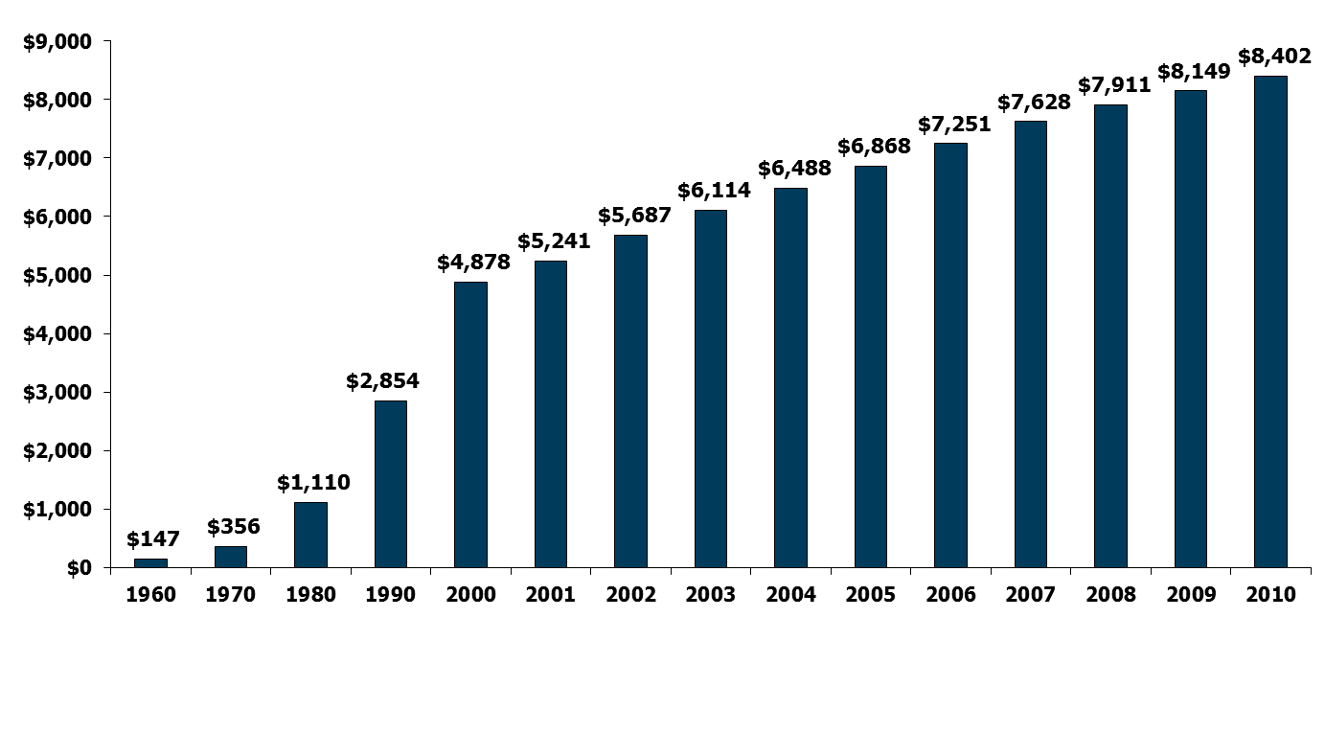
National Health Expenditures per Capita, 1960-2010
NHE as a Share of GDP
5.2% 7.2% 9.2% 12.5% 13.8% 14.5% 15.4% 15.9% 16.0% 16.1% 16.2% 16.4% 16.8% 17.9% 17.9%
Notes: According to CMS, population is the U.S. Bureau of the Census resident-based population, less armed forces overseas.
Source: Centers for Medicare and Medicaid Services, Office of the Actuary, National Health Statistics Group, at http://www.cms.hhs.gov/NationalHealthExpendData/ (see Historical; NHE summary including share of GDP, CY 1960-2010; file nhegdp10.zip).

Slide 9
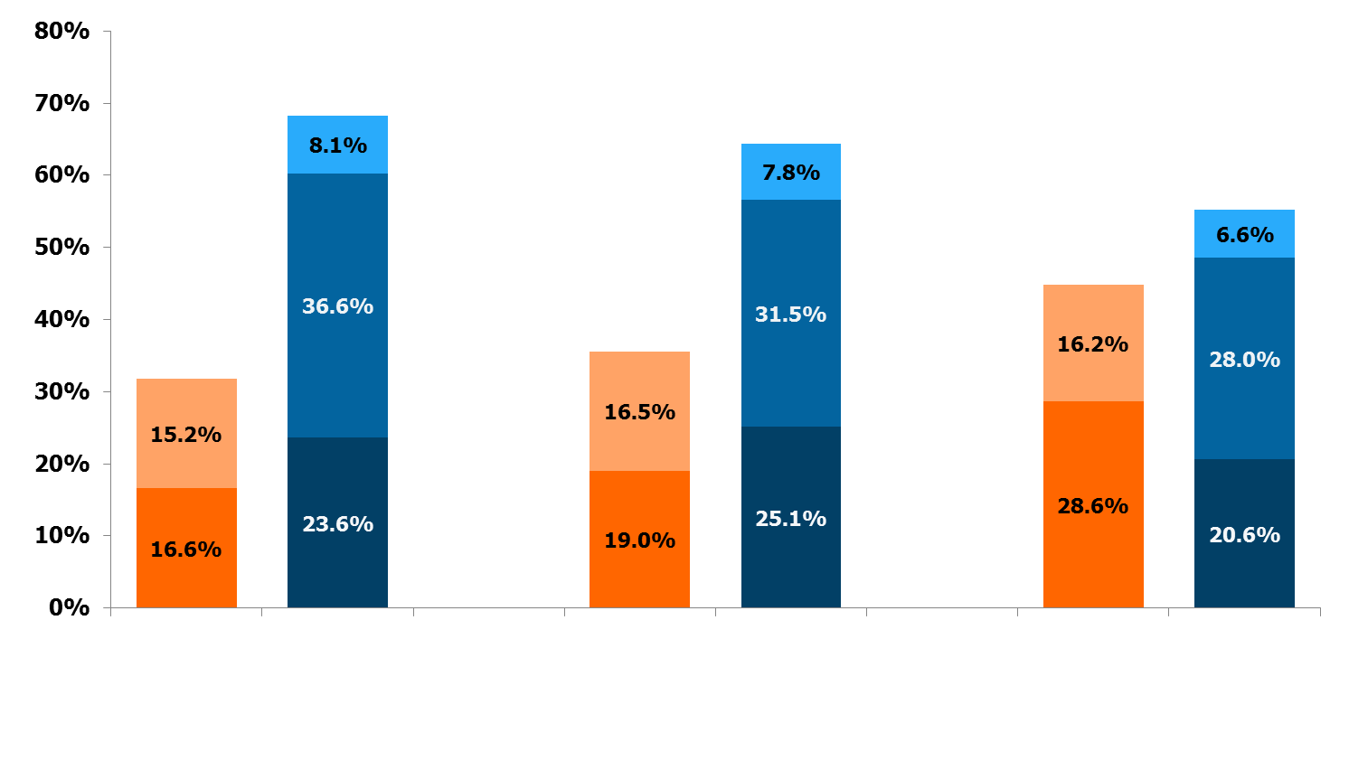
Percent Distribution of National Health Expenditures, by Type of Sponsor, 1987, 2000, 2010
Federal Private Business
State & Local Household
Other Private Revenues
68.2%
64.5%
55.1%
44.9%
35.5%
31.8%
Government Private
Government Private
Government Private
1987 (Total = $519.1 billion)
2000 (Total = $1,377.2 billion)
2011 (Total = $2,700.7 billion)
Notes: Starting with the 2009 NHE data, CMS expanded their focus on spending by Type of Sponsor, which provides estimates of the individual, business, or tax source that is behind each Source of Funds category and is responsible for financing or sponsoring the payments. “Federal” and “State & Local” includes government contributions to private health insurance premiums and to the Medicare Hospital Insurance Trust Fund through payroll taxes, Medicaid program expenditures including buy-in premiums for Medicare, and other state & local government programs. “Private Business” includes employer contributions to private health insurance, the Medicare Hospital Insurance Trust Fund through payroll taxes, workers’ compensation insurance, temporary disability insurance, worksite health care. “Household” includes contributions to health insurance premiums for private health insurance, Medicare Part A or Part B, out-of-pocket costs. “Other Private Revenues” includes philanthropy, structure & equipment, non-patient revenues.
Source: Centers for Medicare and Medicaid Services, Office of the Actuary, National Health Statistics Group at
https://www.cms.gov/NationalHealthExpendData/ (see Historical; NHE Web tables, Table 5).

Slide 10
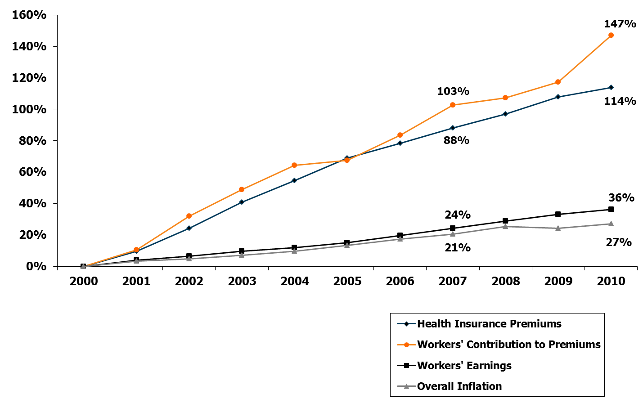
Cumulative Increases in Health Insurance Premiums, Workers’ Contributions to Premiums, Inflation, and Workers’ Earnings, 2000-2010
Notes: Health insurance premiums and worker contributions are for family premiums based on a family of four.
Source: Kaiser/HRET Survey of Employer-Sponsored Health Benefits, 1999-2011. Bureau of Labor Statistics, Consumer Price Index, U.S. City Average of Annual Inflation (April to April), 1999-2011. Bureau of Labor Statistics, Seasonally Adjusted Data from the Current Employment Statistics Survey, 1999-2011 (April to April).

Slide 11
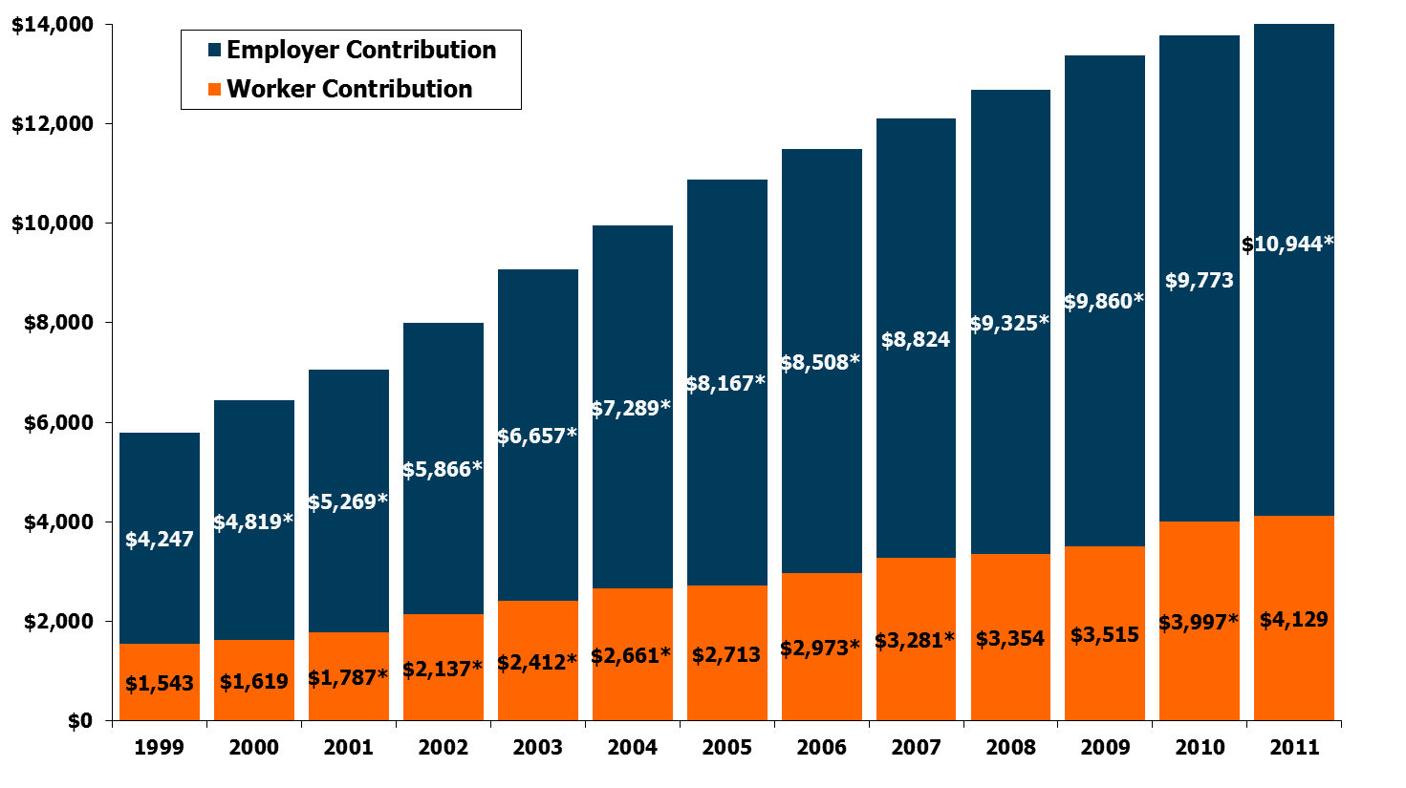
Average Annual Worker and Employer Contributions to Premiums and Total Premiums for Family Coverage,
1999-2011
$13,770*
$15,073*
$13,375*
$12,680*
$12,106*
$11,480*
$10,880*
$9,950*
$9,068*
$8,003*
$7,061*
$6,438*
$5,791
* Estimate is statistically different from estimate for the previous year shown (p<.05).
Source: Kaiser/HRET Survey of Employer-Sponsored Health Benefits, 1999-2011.

Slide 12
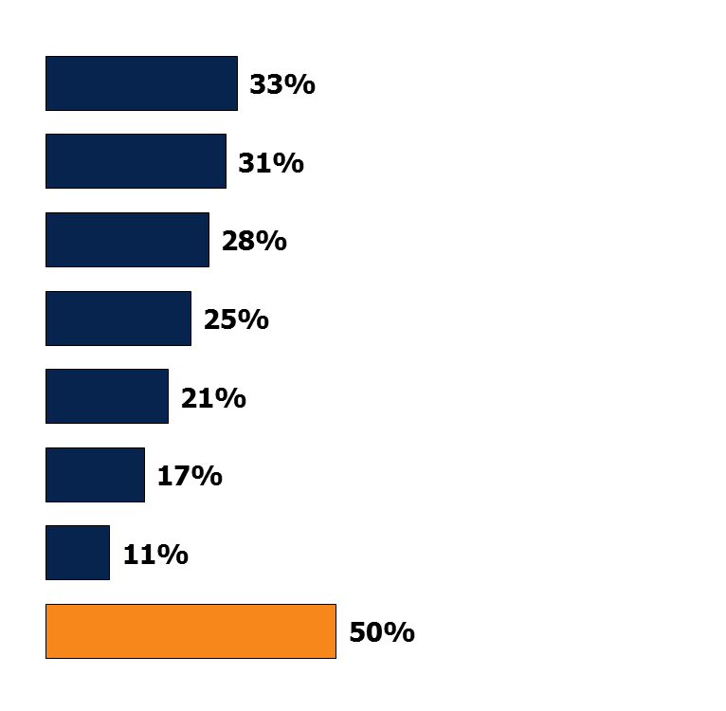
Putting Off Care Because of Cost
Percent who say they or another family member living in their household have done each of the following in the past 12 months because of the cost:
Relied on home remedies or over-the-counter drugs instead of going to see a doctor
Skipped dental care or checkups
Put off or postponed getting health care needed
Not filled a prescription for a medicine
Skipped a recommended medical test or treatment
Cut pills in half or skipped doses of medicine
Had problems getting mental health care
‘Yes’ to any of the above
Source: Kaiser Family Foundation Health Tracking Poll (conducted August 10-15, 2011).

Slide 13
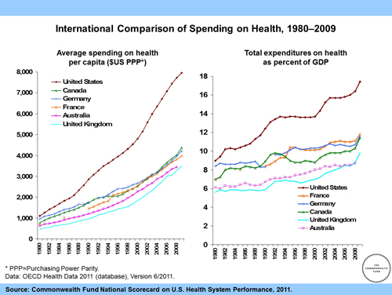

Slide 14
Quality Concerns
much illness is preventable
  estimated that 40-70% of premature deaths are preventable
  1/3 of acute disability is preventable
  2/3 of chronic illness/disability is preventable
US system biased toward too little prevention/too much treatment
questions about appropriateness of some medical treatments
don’t look good on basic health status measures
http://www.cmwf.org/Content/News/News-Releases/2007/May/New-Update-of-International-Health-System-Comparisons.aspx

Slide 15
What is poor quality?
discrimination
disparities
geographic maldistribution
lack of continuity of care
inadequate or lack of prenatal care
failure to provide beneficial prevention
substandard/incompetent providers
JAMA article
Notes:
(JAMA, Physicians for a National Health Insurance Plan)

Slide 16
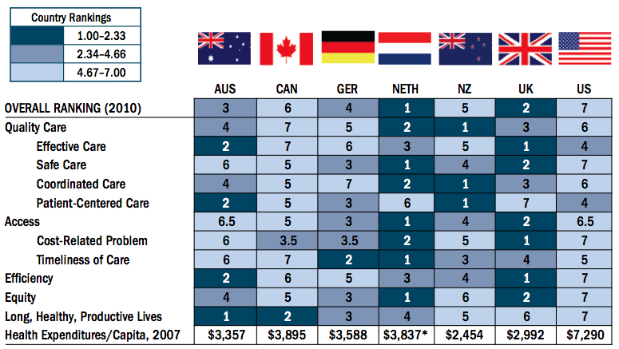
International Rankings
Source: Commonwealth Fund, 2010

Slide 17
Access Barriers
Lack of insurance or matching insurance to provider (not all providers accept all types of insurance)
Shortage of Providers in some areas: HPSA and MUA designations
  Inner city and rural
  Distance (more than 30 minutes)
And what of predictions of impending shortage of providers overall due to changing demographics?

Slide 18
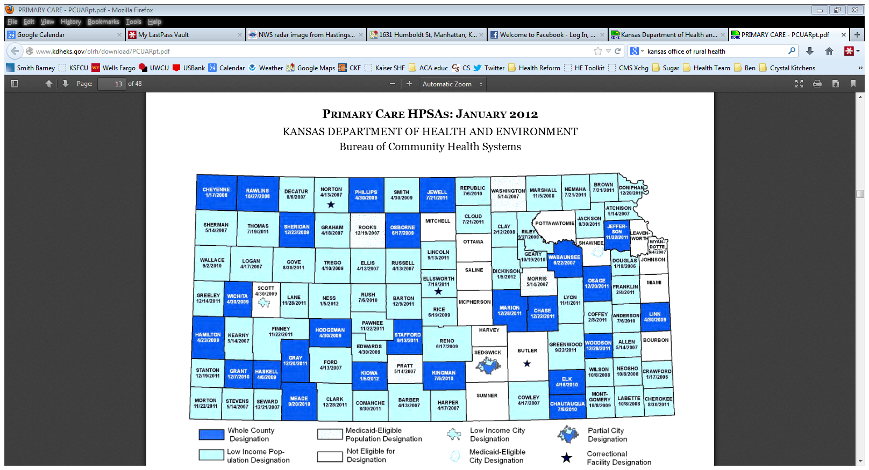

Slide 19
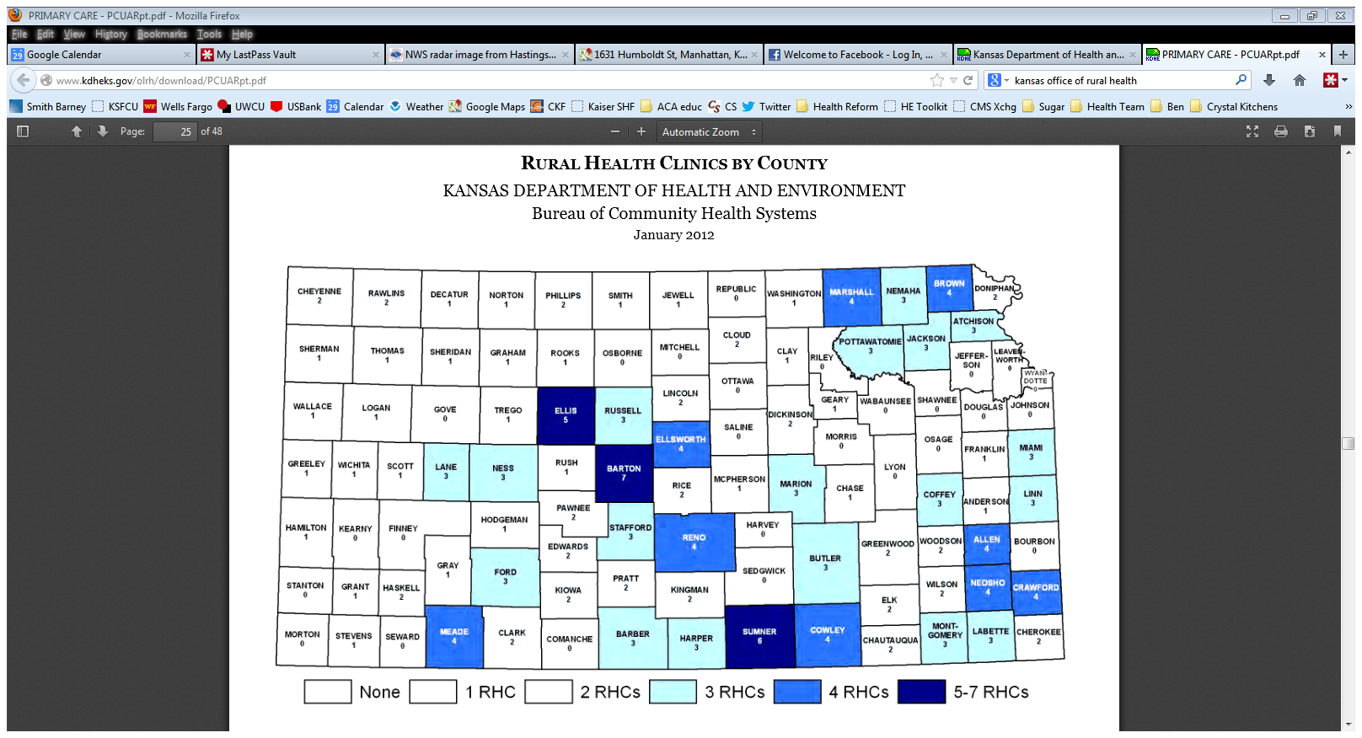

Slide 20
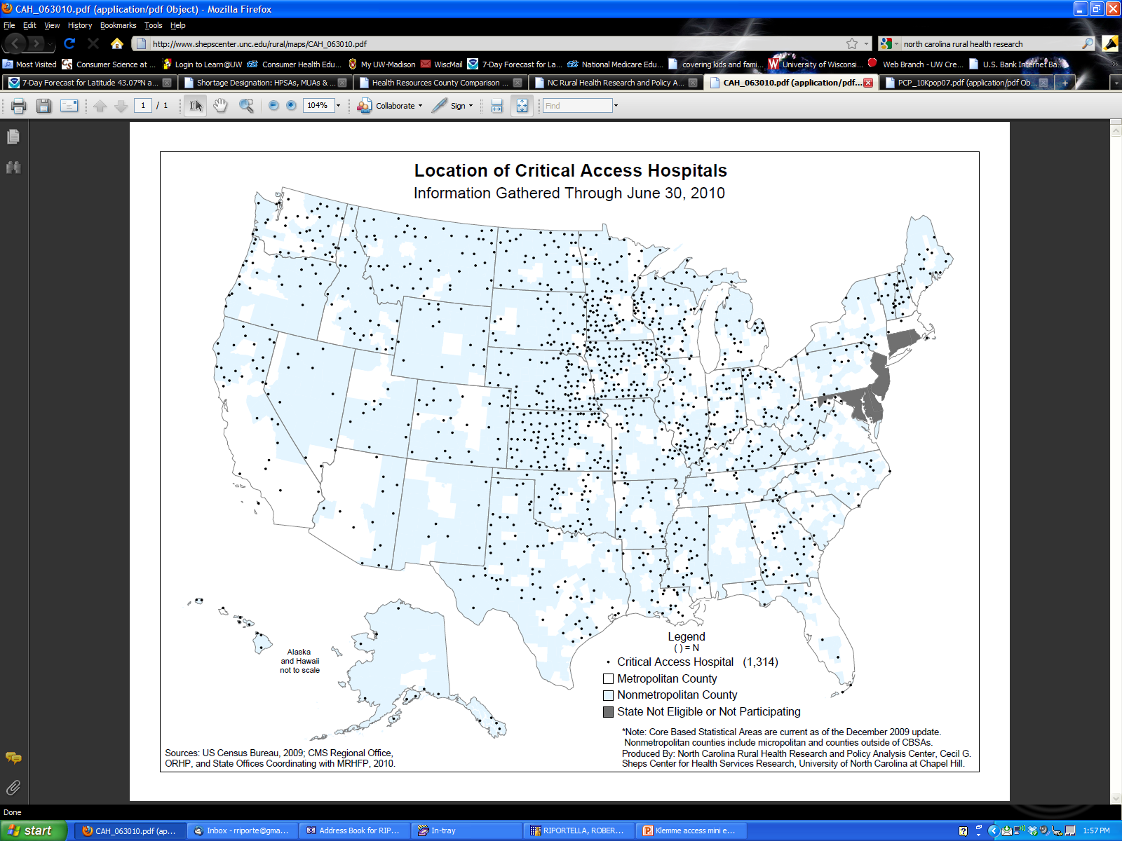

Slide 21
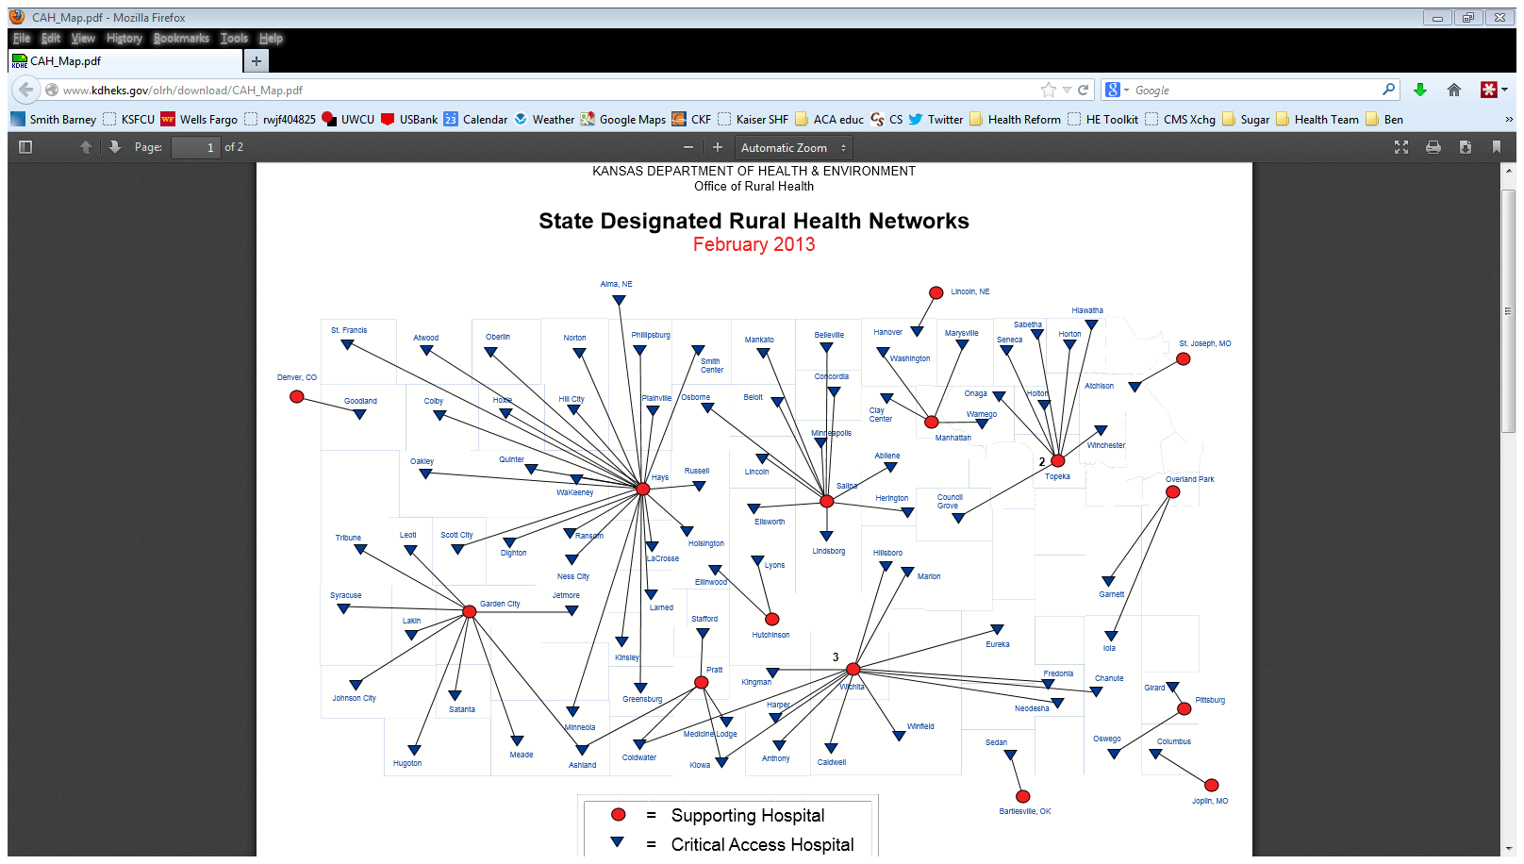
Notes:
Critical Access Hospitals
The Critical Access Hospital program is part of a larger federal program, the Medicare Rural Hospital Flexibility (FLEX) program. The FLEX program is administered by the Kansas Rural Health Options Project (KRHOP). KRHOP is a partnership of the Kansas Department of Health and Environment Office of Local and Rural Health, the Kansas Hospital Association, the Kansas Board of Emergency Medical Services and the Kansas Medical Society.
The FLEX program is a major national initiative to strengthen rural health care by:
Offering cost-based reimbursement for Medicare acute inpatient and outpatient services.
Encouraging the development of rural health networks.
Offering grants to states to help implement a state FLEX program in the context of broader initiatives to strengthen the rural health care infrastructure.
For more information regarding the Critical Access Hospital Program, contact Chad Austin at (785) 233-7436.
Critical Access Hospitals and Rural Health Networks
Critical Access Hospitals are facilities designated by the federal Centers for Medicare and Medicaid Services. CMS provides CAHs with:
Relaxed staffing requirements in comparison to full-service hospitals; and
Federal grant assistance for prospective CAHs and designated network.
Click here to view a map of the state designated Rural Health Networks in Kansas. Facilities wishing to obtain additional information about Critical Access Hospital certification or techincal assistance should contact KHA at (785) 233-7436.
CAHs Links
A list of links that will take you to sites providing more information about KRHOP, FLEX and Critical Access Hospitals.

Slide 22
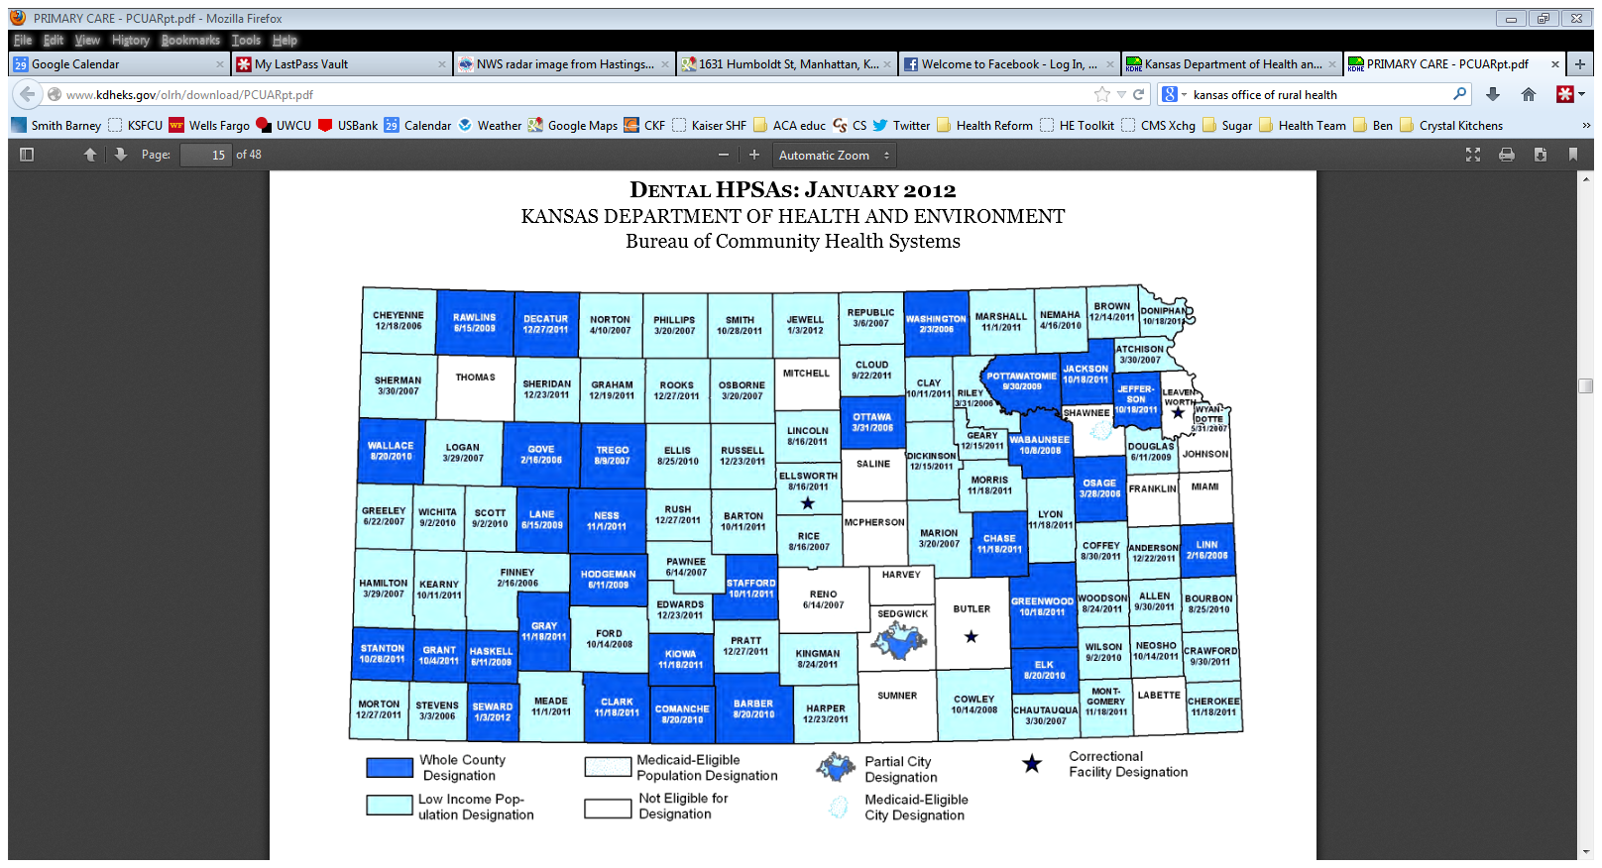

Slide 23
Access
Ability to pay
  could pay out of pocket or by insurance
  not like other commodities
    basic human need
    purchase price unpredictable
    unknown purchase
  most rely on health insurance

Slide 24
Current Insurance Program
Public sector
  government programs
Private sector
  individual insurance
  employer-employee programs
    fringe benefit rather than salary
    non-taxable benefit
      >$75 billion subsidy to corporations and individuals

Slide 25
Public Sector
Medicare
Medicaid
State Children Health Insurance Program (BadgerCare Plus)
Veterans Administration (Tricare: managed care option; Tricare Standard is FFS option; formerly CHAMPUS) http://www1.va.gov/health/index.asp
Indian Health Service http://www.ihs.gov/
Worker’s Compensation

Slide 26
Private Health Insurance Market
Individual and small group
Large employee-employer group

Slide 27
Kansas Health Care Data
Kansas Health Institute
http://www.khi.org/news/reports&briefs/
Annual Insurance Update
http://www.khi.org/news/2013/apr/17/annual-insurance-update-2012/?research

Slide 28
Kansans with Private Health Insurance
Source: KHI, 2012

Slide 29
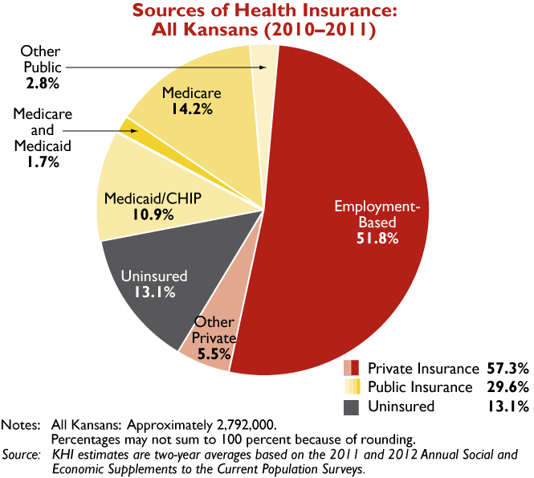

Slide 30
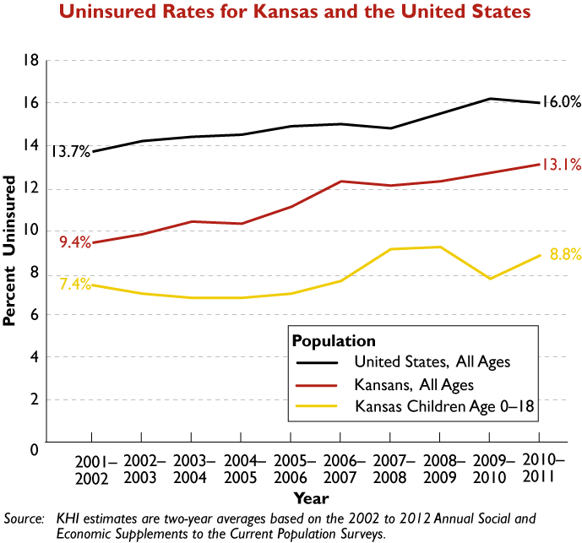

Slide 31
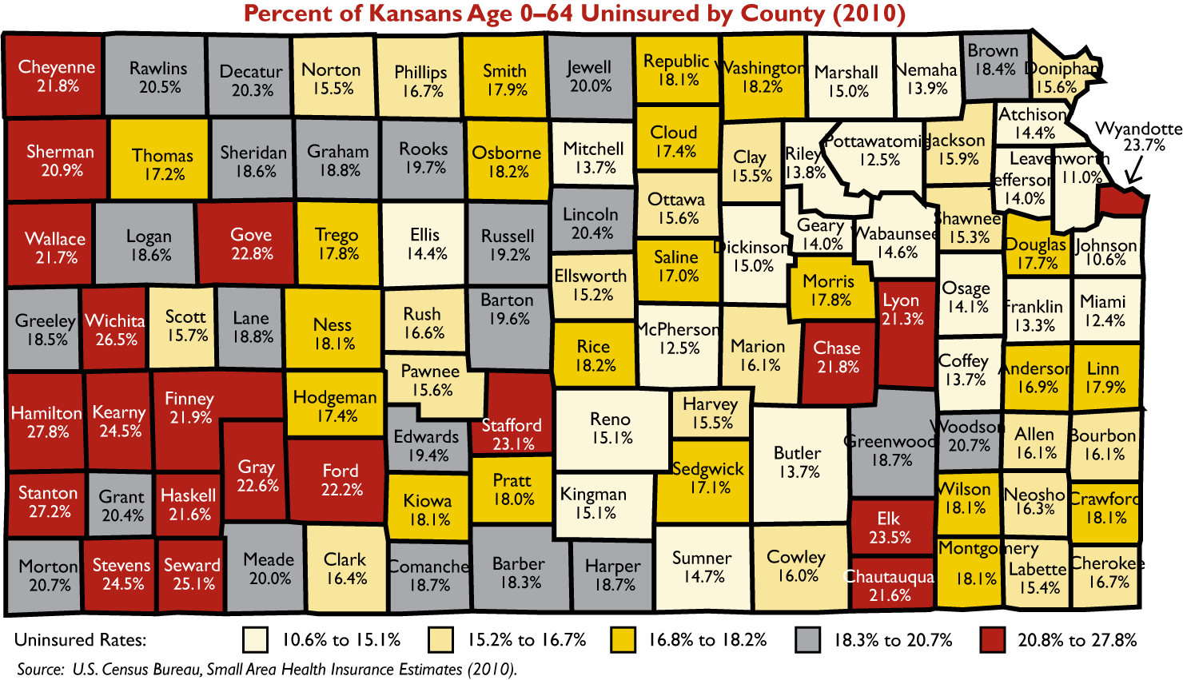

Slide 32
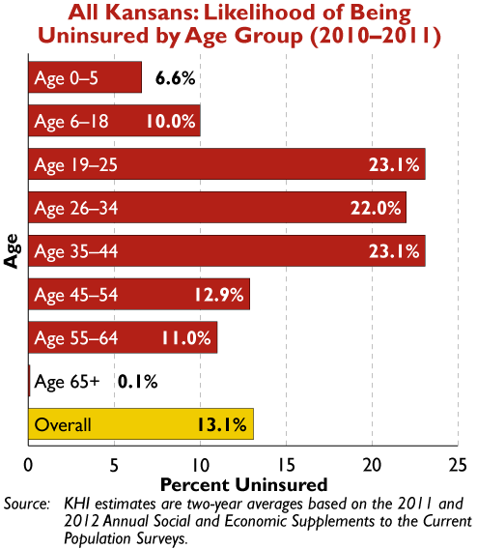

Slide 33
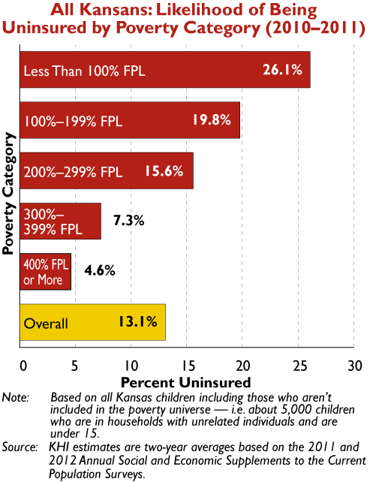

Slide 34
Five facts about the uninsured
Most of the nation’s 47.9 million uninsured have low or moderate incomes
More than ¾ are in a working family
Medicaid and CHIP provide a key source of coverage for many who lack access to affordable coverage
About 25% or ¼ uninsured adults go without needed care due to cost compared to 4% of those with private insurance
Medical bills are a burden for the uninsured and frequently leave them with debt.
Kaiser Commission on Medicaid and the Uninsured, Sept 2012.

Slide 35
The cost of being uninsured
  The risk of premature death among uninsured Americans is 25% higher than among Americans with health insurance
  Estimated 18,000 Americans die each year as a result of being uninsured
  Institute of Medicine (2004)

Slide 36
Communities with more uninsureds
  More difficulty recruiting and retaining physicians
  Hospitals have less trauma and burn care, more ER crowding and diversion
  Insured patients have lower quality, access, and satisfaction
Notes:
In places with high rates of uninsurance

Slide 37
How to respond?
  To solve problems of
    Costs, quality and access
  Research based evidence
  Mixed with messy political process brought us
  The Affordable Care Act

Slide 38
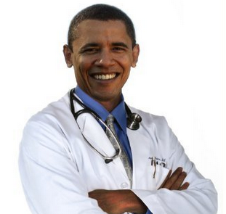
ObamaCare

Slide 39

Confused? Here’s why…
It’s a big law…
with 10 provisions …
and implications for most Americans

Slide 40


Slide 41
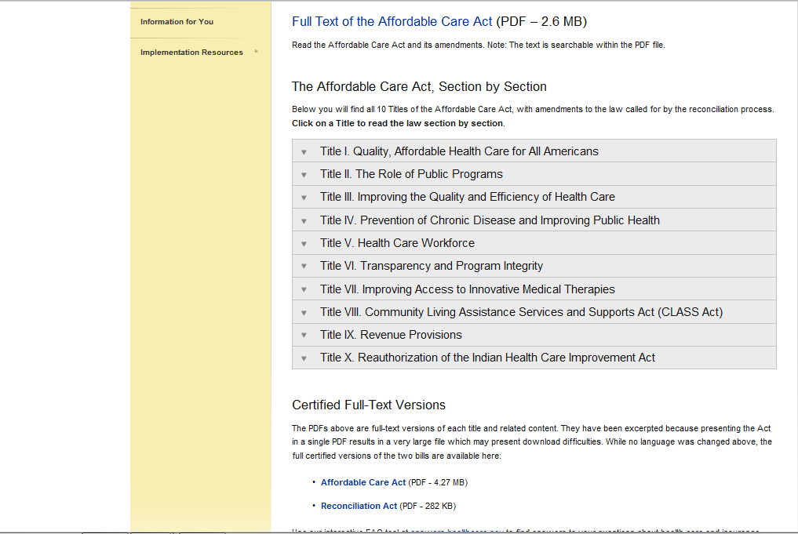
Provisions of the Affordable Care Act
Healthcare.gov; http://www.healthcare.gov/law/full/index.html

Slide 42

Healthcare.gov Timeline; www.healthcare.gov/law/timeline/index.html

Slide 43
ACA: Intertwined goals
Make better health insurance coverage more available and affordable for legal residents
Reform health care delivery and financing to provide better quality and outcomes, more cost effective care

Slide 44
Comprehensive changes to health care insurance and delivery systems
Changes rules and funding for health insurance, trying to decrease number of uninsured
  Holding insurance companies accountable
  Guarantee more choice
  Offer more affordable insurance
Includes incentives for preventive and wellness programs
Provides money to improve access to providers
Lower health care costs for system
Affects all population groups and communities yet
Leaves current private insurance marketplace in place

Slide 45
More comprehensive changes
Provides new eligibility rules for Medicaid and creates changes in Medicare
  Expands Medicaid
  Authorizes Medicare financing and delivery reform

Slide 46
What the law does: Other
Provides grants to various groups and organizations to improve the overall health care system through innovation cross-profession expertise
  The outreach component is the responsibility of the Center for Medicare and Medicaid Services (CMS) and they have funds to contract with organization around educating consumers

Slide 47
Consumer protections: 4 things to know
Ends the worst insurance company abuses
Makes health insurance more affordable
Strengthens Medicare
Provides better options for coverage

Slide 48
Consumer Protections
Already because of ACA, it is illegal for insurance companies to:
Deny coverage to children because of a pre-existing condition like asthma or diabetes.
Put a lifetime cap on how much care they will pay for if you get sick.
Cancel your coverage when you get sick by finding a mistake on your paperwork.
And more…
Notes:
The first way the law helps you is by putting in place some new consumer protections.
In the past, insurance companies could take advantage of you. They could deny coverage to children who had asthma or were born with a heart defect.
They could also put a lifetime cap on the amount of care they would pay for. So if you developed a serious condition like cancer or a rare blood disease, or you were injured in a car crash, your insurance could disappear when you needed it most.
And worst of all, they could cancel your coverage when you got sick just by finding an accidental mistake in your paperwork. Some insurance companies even used computer programs designed to search the records of people with breast cancer or HIV looking for these errors.

Slide 49


In many cases, you can get preventive services for free:
The law makes health insurance more affordable
Cancer screenings such as mammograms & colonoscopies
Vaccinations such as flu, mumps & measles
Blood pressure screening
Cholesterol screening
Tobacco cessation counseling and interventions
Birth control
Depression screening
And more…
Visit www.healthcare.gov/prevention for a full list.
Notes:
The second way the law helps you is by making health insurance more affordable.
That starts with preventive care. We know that getting preventive care like cancer screenings and vaccines is one of the best ways to stay healthy. But in the past, too many Americans went without this care because their insurer didn’t cover it or required expensive co-pays. When the choice was $50 for a mammogram or $50 for groceries, many women had to take their chances.
Now, they don’t have to take that risk. Thanks to the health care law, a wide range of recommended preventive services are available for free in all new plans. In 2011 alone, 54 million Americans got at least one free preventive service through their private health insurance plans.

Slide 50


The law makes health insurance more affordable
BEFORE, insurance companies spent as much as 40 cents of every premium dollar on overhead, marketing, and CEO salaries.
TODAY, the new 80/20 rule says insurance companies must spend at least 80 cents of your premium dollar on your health care or improvements to care.
If they don’t, they must repay the money.
($1 Billion already returned)
60% / 40%
80% / 20%
Notes:
The law also helps you get more value for your health care premium. Before the law, some private insurance companies spent almost half of your premium on overhead like marketing and CEO salaries, leaving as little as 60 cents of every premium dollar to spend on care.
The health care law gets you more bang for your buck by creating the new 80/20 rule: in general, insurers must now spend at least 80 percent of your premium on health care services or improving care or they have to repay the money.

Slide 51

The law strengthens Medicare
Free preventive services such as mammograms, colonoscopies and an annual wellness visit.
A 50% discount on covered brand-name medications for those in the prescription drug donut hole – an average savings of more than $650 per person.
Strong anti-fraud measures, including
tougher penalties for criminals.
Notes:
The third way the law helps Americans is by providing new benefits for the nearly 50 million older Americans and Americans with disabilities who rely on Medicare each year.
It makes many key preventive services available with no co-pay or deductible to help ensure that no senior has to skip a potentially life-saving cancer screening because they can’t afford it. Already, 32 million people with Medicare have received a free preventive benefit.
The law provides relief to people in the Medicare Part D prescription drug coverage gap – known as the “donut hole.” Now, those in the donut hole can get a 50% discount on their covered brand-name medications –discounts that have saved seniors an average of more than $650 each thanks to the law. And the donut hole will be closed in 2020.
The law also provides a historic boost to efforts that crack down on Medicare fraud. These efforts helped return a record $5.7 billion to the Medicare trust fund in 2010 and 2011.
And Medicare’s trustees say that the savings from improvements like reducing fraud will extend the life of the Medicare Trust Fund by eight years.
[SPEAKER’S REFERENCE:
Before the law, under Medicare Part D, seniors in the donut hole had to cover all out of pocket prescription drug costs between about $2700 and $6100. ]

Slide 52
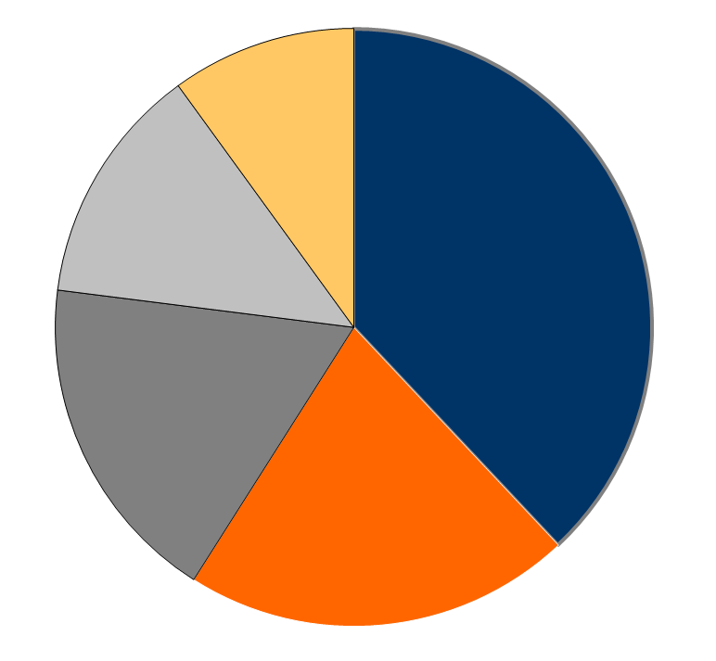
Prescription Drug Coverage
Among Medicare Beneficiaries, 2010
No Drug Coverage
Stand-Alone Prescription Drug Plan (PDP)
4.7
million
10%
Other Drug Coverage¹
5.9
million
13%
Total in
Part D Plans:
27.7 Million
(60%)
17.7
million
38%
8.3 million
18%
Retiree Drug Coverage²
9.9 million
21%
Medicare Advantage Drug Plan
Total Number of Medicare Beneficiaries = 46.5 Million
Notes:
NOTES: Numbers do not sum to 100 percent due to rounding. ¹Includes Veterans Affairs, retiree coverage without RDS, Indian Health Service, state pharmacy
assistance programs, employer plans for active workers, Medigap, multiple sources, and other sources. ²Includes Retiree Drug Subsidy (RDS) and FEHBP and
TRICARE retiree coverage.
SOURCE: Centers for Medicare & Medicaid Services, 2010 Enrollment Information (as of February 16, 2010).

Slide 53
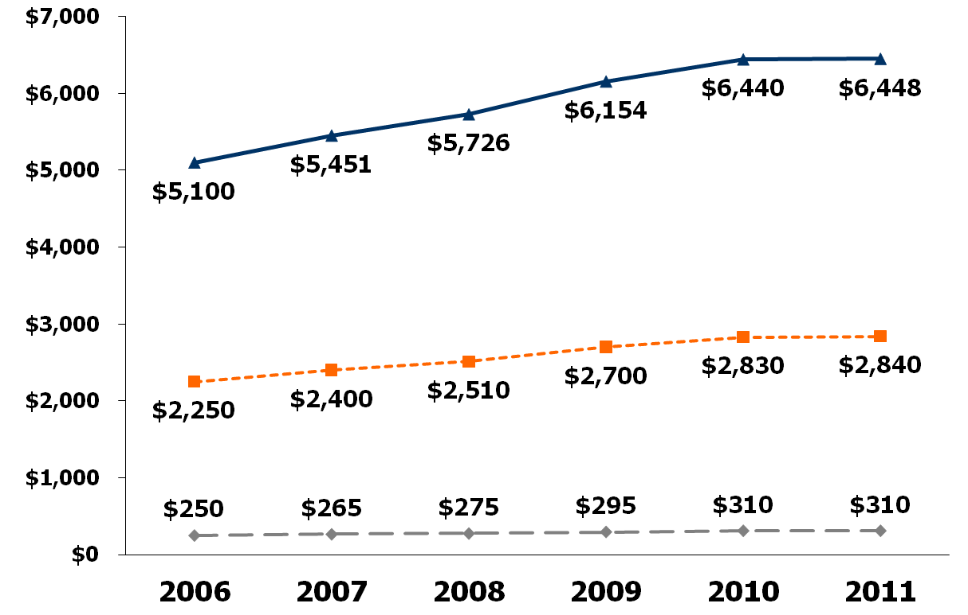
Medicare Part D Standard Benefit Parameters,
2006-2011
Total drug spending:
Catastrophic Limit
Coverage Gap
$3,454
$3,610
$3,608
$3,051
$3,216
$2,850
Initial Coverage Limit
Deductible
NOTE: Estimates rounded to nearest whole dollar. Enrollees in non-standard benefit plans may face different thresholds depending on the design of their Part D plan benefits and cost-sharing amounts.
SOURCE: Centers for Medicare & Medicaid Services.

Slide 54
Medicare changes: cont’d.
Medicare Advantage Plans
  Prohibits Medicare Advantage plans from imposing higher cost-sharing requirements
  Reduced federal payments to Advantage plans
    Some insurers could stop offering additional benefits such as glasses and gym memberships
    Basic Medicare benefits can’t be cut
Notes:
54
Other changes that will be beneficial for seniors are that Medicare Advantage plans can no longer impose higher cost-sharing requirements, and starting in 2014 it will be easier to qualify for catastrophic coverage.
Note: Beginning in 2012, Medicare Advantage reimbursement rates to physicians and hospitals will begin to be lowered to traditional Medicare fee-for-service reimbursement rates, as payments to Medicare Advantage plans are currently higher than traditional plans.

Slide 55

The law provides better options for getting coverage
For millions of Americans who buy their own coverage, lose their coverage, or have no coverage at all, the law provides better options.
Notes:
The third way the law helps Americans is by providing new benefits for the nearly 50 million older Americans and Americans with disabilities who rely on Medicare each year.
It makes many key preventive services available with no co-pay or deductible to help ensure that no senior has to skip a potentially life-saving cancer screening because they can’t afford it. Already, 32 million people with Medicare have received a free preventive benefit.
The law provides relief to people in the Medicare Part D prescription drug coverage gap – known as the “donut hole.” Now, those in the donut hole can get a 50% discount on their covered brand-name medications –discounts that have saved seniors an average of more than $650 each thanks to the law. And the donut hole will be closed in 2020.
The law also provides a historic boost to efforts that crack down on Medicare fraud. These efforts helped return a record $5.7 billion to the Medicare trust fund in 2010 and 2011.
And Medicare’s trustees say that the savings from improvements like reducing fraud will extend the life of the Medicare Trust Fund by eight years.
[SPEAKER’S REFERENCE:
Before the law, under Medicare Part D, seniors in the donut hole had to cover all out of pocket prescription drug costs between about $2700 and $6100. ]

Slide 56
The law provides better options for getting coverage
Young adults under the age of 26 can now stay on their parents’ health plans.
“I honestly don’t know what we would have done…. There was no way we could have afforded it. I might not be here right now.”
--Kylie L., 23, in Illinois, who credits the health care law for enabling a life-saving heart transplant
Notes:
The third way the law helps Americans is by providing new benefits for the nearly 50 million older Americans and Americans with disabilities who rely on Medicare each year.
It makes many key preventive services available with no co-pay or deductible to help ensure that no senior has to skip a potentially life-saving cancer screening because they can’t afford it. Already, 32 million people with Medicare have received a free preventive benefit.
The law provides relief to people in the Medicare Part D prescription drug coverage gap – known as the “donut hole.” Now, those in the donut hole can get a 50% discount on their covered brand-name medications –discounts that have saved seniors an average of more than $650 each thanks to the law. And the donut hole will be closed in 2020.
The law also provides a historic boost to efforts that crack down on Medicare fraud. These efforts helped return a record $5.7 billion to the Medicare trust fund in 2010 and 2011.
And Medicare’s trustees say that the savings from improvements like reducing fraud will extend the life of the Medicare Trust Fund by eight years.
[SPEAKER’S REFERENCE:
Before the law, under Medicare Part D, seniors in the donut hole had to cover all out of pocket prescription drug costs between about $2700 and $6100. ]

Slide 57

The law provides better options for getting coverage
  Starting in 2014:
Discriminating against people with pre-existing conditions or because they are women will be illegal.
There will be new State-based marketplaces – called Affordable Insurance Exchanges – where you’ll have a choice of private plans.
Tax credits will make buying insurance more affordable.
Notes:
The third way the law helps Americans is by providing new benefits for the nearly 50 million older Americans and Americans with disabilities who rely on Medicare each year.
It makes many key preventive services available with no co-pay or deductible to help ensure that no senior has to skip a potentially life-saving cancer screening because they can’t afford it. Already, 32 million people with Medicare have received a free preventive benefit.
The law provides relief to people in the Medicare Part D prescription drug coverage gap – known as the “donut hole.” Now, those in the donut hole can get a 50% discount on their covered brand-name medications –discounts that have saved seniors an average of more than $650 each thanks to the law. And the donut hole will be closed in 2020.
The law also provides a historic boost to efforts that crack down on Medicare fraud. These efforts helped return a record $5.7 billion to the Medicare trust fund in 2010 and 2011.
And Medicare’s trustees say that the savings from improvements like reducing fraud will extend the life of the Medicare Trust Fund by eight years.
[SPEAKER’S REFERENCE:
Before the law, under Medicare Part D, seniors in the donut hole had to cover all out of pocket prescription drug costs between about $2700 and $6100. ]

Slide 58

ACA and Insurance Reforms
Preventive Aspects
  Free preventive care for those with insurance, including Medicare
Financial Aspects
  Financial assistance for seniors for prescription drugs
  No lifetime limits on coverage of essential benefits
  Tax breaks for small businesses to provide coverage (2010-2016)
Access to insurance
  Young adults can stay on parent’s private insurance plans until age 26
  Children cannot be denied coverage for having pre-existing condition (Adults Jan 2014)

Slide 59
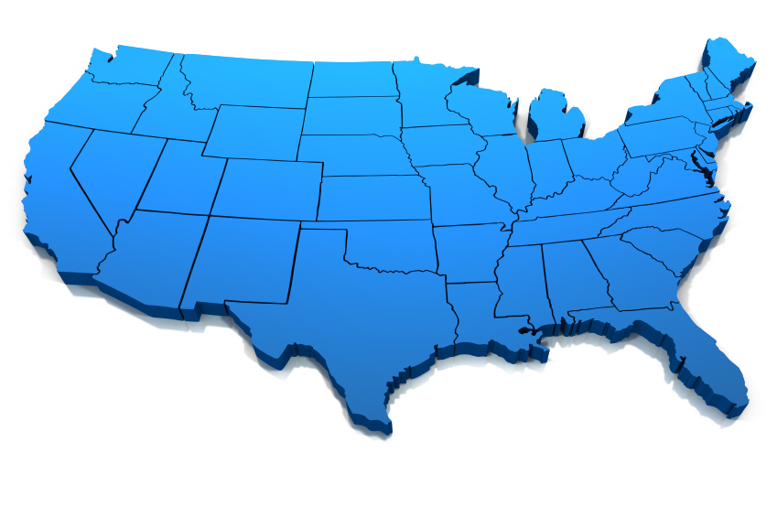

The Law Increases Access to Care
Notes:
We all know that health insurance doesn’t guarantee you’ll get the care you need. In the past, you’d call up your doctor and too often you’d hear that the next appointment was in four months. Or you’d only see your doctor for ten minutes because they had to rush on to their next patient.
That’s why the health care law also invests in training and placing thousands of new doctors and nurses in communities that need them most. And it creates and expands community health centers across the country.
These investments will make it easier for you to see your doctor and spend more time with them.
[FOR THE SPEAKER’S REFERENCE:
-Community health centers are an economic engine of local employment and growth in many underserved and low-income communities.
-Since the beginning of 2009, health centers have added more than 18,600 new full time positions in many of the nation’s most economically distressed communities, and because of the health care law, they are expected to create thousands more.]

Slide 60
Healthcare Workforce Incentives
$168 million to train 500 new primary-care physicians over the next five years,
$30 million to encourage 600 nursing students to attend school full-time and complete their education, and
$32 million to create 600 new physician assistants.

Slide 61

Personal and Social Responsibilities
Personal responsibility:
  Making healthy choices for oneself
Social responsibility:
  Responsibility of government, communities, and corporations
  Considers health of whole population

Slide 62
Rewarding Responsibility
Rewards Medicare and Medicaid enrollees for completing behavior modification programs
Requires Medicaid coverage of smoking cessation services for pregnant women
Gives free annual wellness visits for those on Medicare
  Prevention plan services and health risk assessment
Free preventive services for all on insurance (July 2012)

Slide 63
Federal & State Health Promotion Efforts
Creates a National Council to coordinate federal prevention, wellness, and public health activities
Offers new prevention research and health screenings, education and outreach

Slide 64
Promoting Health At Work
Gives grants to employers for up to 5 years for wellness programs
Funds grants for employers to reward employees for entering wellness programs
Requires chain restaurants to state nutrition content on all items
Employers must provide a break time and also offer a separate location (other than bathroom) for breastfeeding

Slide 65
Making Communities Healthier
Community Transformation Grants
  Competitive state grants for preventive services to reduce disease and address health disparities
Grants for more community health workers
Individualized Wellness Plan Project
  Pilot program giving wellness plans to at-risk populations using health centers
Notes:
Most individuals will be required to have insurance, WHO WOULDN’T BE REQUIRED?
Exempt include: pregnant women, persons with disabilities, American Indians, those aging out of foster care
 those for whom premium would exceed 8% of annual adjusted gross income
 American Indian tribes
 Financial hardship waiverees
 Those who lacked insurance for less than 3 months
Between $500 M and $1 B in federal premium tax credits will be available to Wisconsin residents annually
Family of 4 earning $75,000 annually
$11,104 annual premium
$3979 in savings
$7125 is amount family pays (~$600/mo)
Single woman earning $30,000 annually
$4500 annual premium
$1991 in savings
$2509 is amount individual pays (~$200/mo)

Slide 66
ACA: What it doesn’t do
  Does not create “government-controlled” or “socialized” health care
  Does not create “death panels”
  Does not turn the system over to insurance companies

Slide 67
Nation Still Divided on ACA
As you may know, a health reform bill was signed into law in 2010. Given what you know about the health reform law, do you have a generally favorable or generally unfavorable opinion of it?
ACA signed into law on March 23, 2010
SOURCE: Kaiser Family Foundation Health Tracking Polls

Slide 68
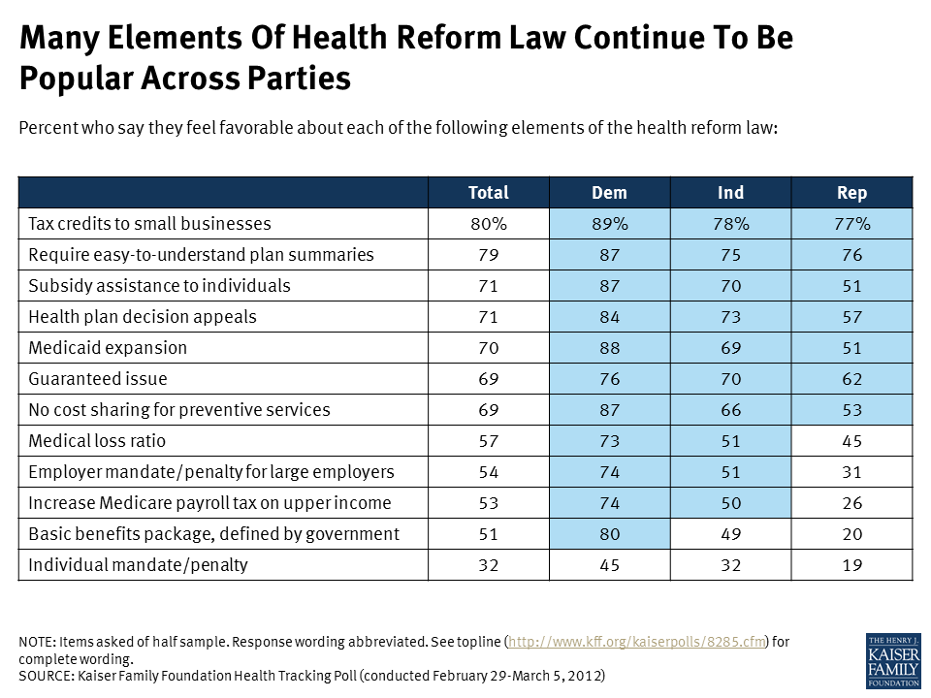

Slide 69
Is ACA here to stay?
  Passed into law on March 23, 2010
  SCOTUS ruled on challenge June 2012
    mandate to be insured upheld
    Medicaid Expansion not upheld
  As with any law, there may be future challenges or changes.
  Some provisions already in effect.
  Major implementation January 1, 2014

Slide 70
ACA and the Mandate Jan. 2014
Most individuals will be mandated to have insurance BUT:
  Government will provide tax credits to some who can’t afford it (some exempt)
  Individuals without access to insurance can purchase coverage through a marketplace (intent to be affordable in large purchasing pools)
  Adults cannot be denied coverage for pre-existing conditions
  States can choose to cover more individuals by expanding their Medicaid programs

Slide 71
Do mandates work?
2.7%
2009

Slide 72
Will everyone be required to have insurance in 2014?
Some individuals may be exempt, including:
  Pregnant women
  Individuals with disabilities
  American Indians
  Youth aging out of foster care
  Individuals with low incomes that cause insurance to be unaffordable
Notes:
TELL:
Most individuals will be required to have insurance or pay a tax penalty.
The penalty for people who forego insurance is the greatest of two amounts: a specified percentage of income or a specified dollar amount. The percentages of income are phased in over time at 1% in 2014, 2% in 2015, and 2.5% starting in 2016. The dollar amounts are also phased in at $95 in 2014, $325 in 2015, and $695 beginning in 2016 (with annual increases after that). The Congressional Budget Office projects that 3.9 million people will pay the penalty in 2016. The total penalty for the taxable year will not exceed the national average of the annual premiums of a bronze level health insurance plan offered through the health insurance Exchanges.
Health insurance plans will provide documents to people they insure that will be used to prove that they have the minimum coverage required by law.
Some individuals may be exempt, including:
Pregnant women
Individuals with disabilities
American Indians
Youth aging out of foster care
Individuals with low incomes that cause insurance to be unaffordable
If insurance would cost more than 8% of their income
If they are under the income threshold to file taxes

Slide 73
How Many are Affected Per Year by the
Individual Mandate?
32 million previously uninsured affected by the mandate
24 million qualify for exemptions from the mandate
219 million insured by employer coverage, Medicaid, Medicare’s disability coverage, or individual insurance and not affected by the mandate
Projected Non-Elderly in 2016= 275 million
SOURCE: Kaiser Family Foundation analysis; Congressional Budget Office; Jonathan Gruber

Slide 74

Can I keep the insurance I have?
  Individuals with insurance through their employers or private insurance do not have to change their plans, but can still compare other options.
  Individuals who qualify for Medicare or Medicaid will continue to be eligible for those programs.
Individuals who don’t have insurance will be required (mandated) to purchase it
Notes:
TELL:
Many constituents question whether they have to use the health insurance marketplace if they are already comfortable with their existing insurance. The answer is that people can most certainly keep the insurance coverage they have whether public, private or through their employer. However, the marketplace is accessible to all and they can use them to look at other options if they are interested.

Slide 75

The Three-legged Stool Approach
Employer Coverage
Marketplace Coverage
Public Programs
(Medicaid/CHIP/Medicare)

Slide 76
US Health Insurance by Type
Private Insurance
Total: 201 million
Employer: 176.3million
Direct-Purchase: 26.7 million
Public Insurance (non-exclusive)
Total: 87.4 million
Medicaid: 42.6 million
Medicare: 43 million (dual eligibles)
Military healthcare: 11.5 million
Uninsured: 46.3 million
Total
Employer
Total
Direct-
Purchase
Medicaid
Total
Medicare
VA
Notes:
76
Source:
U.S. Census Bureau’s webiste: http://www.census.gov/hhes/www/hlthins/hlthins.html
2010
87% of private is employer based

Slide 77
How will ACA change the
Employer-Based System?
Builds on and expands the employer-based insurance system instead of limiting it
  Gives tax incentives to small businesses for insuring employees
  Fines large employers for not insuring employees
  Requires very large employers to insure by providing employer-sponsored plans
Notes:
Congressional Budget Office (CBO) estimates four different scenarios that all show a decline in Employer-based coverage; all are due to an increase in enrollment through the online marketplaces and Medicaid, rather than a net loss of insured individuals.

Slide 78




ACA for Small Businesses

Slide 79
The Problem
Small businesses haven’t always been able to afford to provide health insurance to their employees. Sometimes, even when insurance options are provided, they are limited and too expensive for employees to access.
The Solution
The ACA makes providing insurance more affordable for many small business employers, expands options in some cases, and limits cost for their employees.
Notes:
Currently, smaller businesses are less likely to offer health insurance coverage to their employees than larger companies: 57% of small businesses with 50 or fewer workers offered health benefits to employees, compared to 92% of businesses with 51 to 100 workers, and 97% of businesses with 101 or more workers in 2011.i
KFF

Slide 80

How ACA works for small businesses
Small businesses with fewer than 50 employees are not mandated to provide insurance coverage.
Employees of small businesses may be eligible for tax credits to purchase insurance on their own in online marketplace if their employers do not to provide it.
Small businesses with fewer than 25 employees are eligible for tax credits if they do decide to offer health insurance to their employees.
Notes:
TELL:
Small businesses with fewer than 50 employees are not mandated to provide insurance coverage, but tax credits are available to offset the costs.
Employees of small businesses may be eligible for tax credits to purchase insurance on their own if their employer chooses not to provide it.
Small businesses with fewer than 25 employees are eligible for tax credits if they do decide to offer health insurance to their employees
2010-2013: Eligible employers receive a tax credit of up to 35% of the employer’s contribution toward insurance premiums. Non-profits may receive 25% of the employer’s contribution.
2014 and after: Credits increase to 50% and 35% respectively

Slide 81
How does the Small Business Tax Credit work?
A small business can qualify for a tax credit if they have:
  Less than 25 FTE*
  Wages that average less than $50,000
    Not counting the owner and his/her family member
  The employer pay 50% or more of the health care costs
They can receive tax credits by filling a Form 8941 on www.irs.gov with their accountant.
* FTE is counted at 30 hours a week

Slide 82
What are the penalties for businesses?
A small business with less than 50 FTE* will not be penalized for not offering health insurance to their employees
Employers with more than 50 FTE can be penalized two ways:
  Not offering health insurance
    $2,000/employee minus 30 first employees
  Not offering affordable health insurance
    $3,000/employee that receives tax subsidy through the health insurance marketplace
* FTE is counted at 30 hours a week
Notes:
If they have only 10 working 40 hrs week but an additional 40 working 30 hrs a week, they reach the 50 and are finable.

Slide 83
Marketplace coverage is a key to ACA
Employer Coverage
Marketplace
Coverage
Public Programs
(Medicaid/CHIP/Medicare)

Slide 84

2014: A New Marketplace
Starting January 1, 2014:
Individuals and small businesses can shop in a new health insurance marketplace featuring:
Standardized insurance products (and better peace of mind);
Tools for comparing options and finding the best plans; and
Strong insurer oversight
http://www.healthcare.gov/marketplace/index.html

Slide 85
Essential Health Benefits
Ambulatory care services
Emergency services
Hospitalization
Maternity and newborn care
Mental health and substance abuse services
Prescription drugs
Rehabilitative and habilitative services and devices
Laboratory services
Preventive and wellness services and chronic disease management
Pediatric services, including oral and vision care

Slide 86
Illustrative Plan Designs for Single Coverage
Tier | Actuarial Value | Deductible | Patient Coinsurance | Out-of-Pocket Limit
Bronze 1 | 60% | $4,375 | 20% | $6,350
Bronze 2 | 60% | $3,475 | 40% | $6,350
Silver 1 | 70% | $2,050 | 20% | $6,350
Silver 2 | 70% | $650 | 40% | $6,350
NOTES: http://www.kff.org/healthreform/upload/8303.pdf
SOURCE: Kaiser Family Foundation
Notes:
Actuarial value: The percentage of total average costs for covered benefits that a plan will cover. For example, if a plan has an actuarial value of 70%, on average, you would be responsible for 30% of the costs of all covered benefits. However, you could be responsible for a higher or lower percentage of the total costs of covered services for the year, depending on your actual health care needs and the terms of your insurance policy.
Actuarial value is defined as “the percentage paid by a health plan of the total allowed costs of benefits” for a standardized population and is a measure both of the value of services covered by the plan and of the cost-sharing that a plan member must cover.
HHS also published on November 20 its AV calculator and an explanation of its AV calculator methodology. The AV calculator only considers in-network utilization, based on a judgment that out-of-network care is only a small part of total utilization.

Slide 87
Purchasing through the Marketplace
  No one can be turned down for insurance
    minimal rating system
      max 3X for age, group/geographic, single/family, smoking status
      NO MEDICAL HISTORY FORMS
  For those 100-400 FPL
    Individual pays 2-9.5% of income toward premium costs, government gives tax credit to cover balance of premium, determined at time of enrollment or with income tax filing
      Smokers have to pay the difference of their additional premiums charged without tax credit help
  Policies will at least meet essential benefit package coverage though other features may vary and OOPS may vary
Notes:
The Patient Protection and Affordable Care Act introduced restrictions on several aspects of underwriting and rating:
Medical underwriting for the purpose of setting rates (i.e., no more medical questionnaires)
Use of ancillary information to set rates (i.e., prior pharmacy use)
Rejecting coverage for prior medical reasons
Gender-specific premium rates or premium rating factors, even though females generally have greater costs than males.
Breadth of rate differences (i.e., ratio between high and low)
For at least the near term, the Patient Protection and Affordable Care Act permits other rating practices that are in place:
Age rating (i.e., use of age based rate differences)
Group experience rating (i.e., use of prior creditable experience to set rates as long as they aren’t based upon specific experience of individuals)
Standardized rate tables for use in exchanges
Use of 2-tier rating structure (i.e., single vs Family coverage). The regulation appears to outlaw the very typical 3-tier rates (i.e., single, 2Party, Family).
Read more: Article: Healthcare Underwriting And Rating Under The Patient Protection and Affordable Care Act | Insurance Thought Leadership

Slide 88
Sliding Scale Tax Credits: Who is Eligible?
Qualify if household income is 100%-400% of Federal Poverty Level and purchase in Marketplace
Household Size | 2013 Federal Poverty Guidelines (400%)
1 | $45,960
2 | $62,040
3 | $78,120
4 | $94,200
5 | $110,280
6 | $126,360

Slide 89
Premium Limits Based on Income
Income | Premium Limit
Up to 133% FPL | 2% of income
133 - 150% FPL | 3 - 4% of income
150 - 200% FPL | 4 - 6.3% of income
200 - 250% FPL | 6.3 - 8.05% of income
250 - 300% FPL | 8.05 - 9.5% of income
300 - 400% FPL | 9.5% of income

Slide 90
Further cost savings for some
Health insurance companies offering coverage through the Marketplace must lower the amount you pay out of pocket for essential health benefits if your household income is below the following 2013 amounts.
  Up to $28,725 for individuals
  Up to $38,775 for a family of 2
  Up to $58,875 for a family of 4
If you qualify for out-of-pocket savings, you must choose a Silver plan to get the savings.

Slide 91
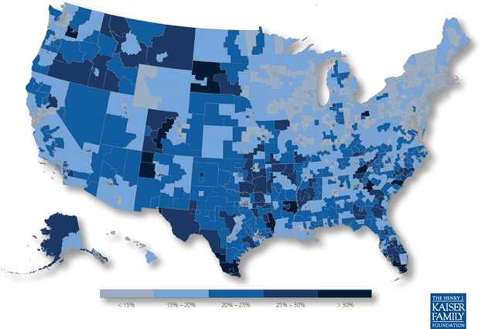
Who Benefits from the Affordable Care Act Coverage Expansions?
Percentage of Nonelderly Population With Income Up to Four Times the Poverty Level
Who Were Uninsured or Purchasing Individual Coverage, 2010

Slide 92
Marketplace
Current Decision Making
How insurers will participate
What types of plans and how many
  Blue Cross Blue Shield of Kansas
  Coventry Health Care of Kansas
  Blue Cross Blue Shield of Kansas City (Wyandotte and Johnson Counties only)
What types of assistance will be available to help people enroll
  Navigators (federal)
  Navigators/Assistors (state)
Building IT infrastructure

Slide 93
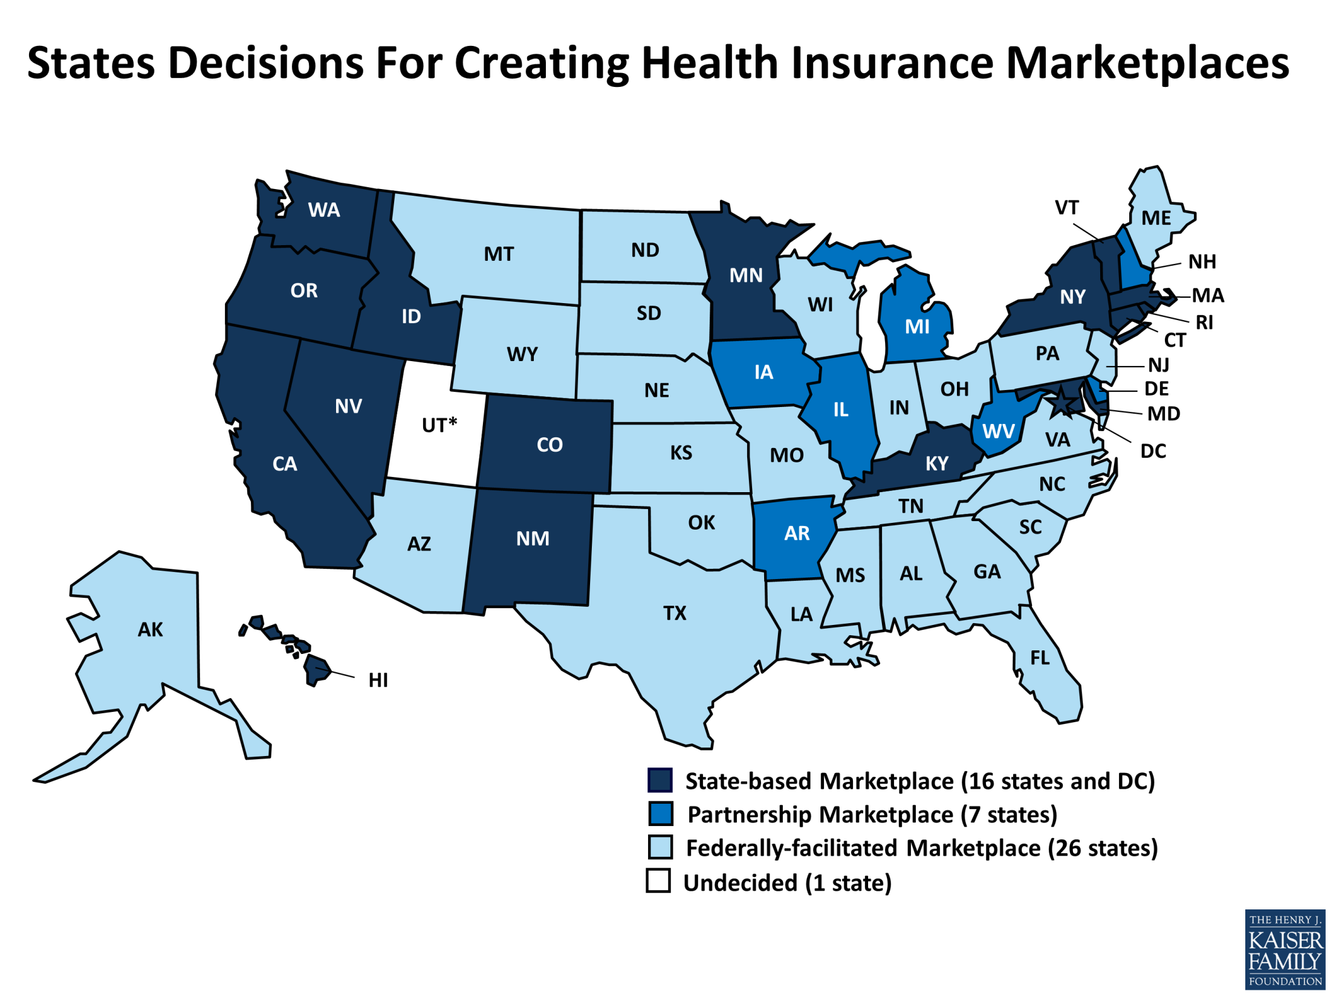

Slide 94
Federal vs State Marketplaces
Should work same way
  Bronze, silver, gold and platinum and young adults' plans
  States could adopt rules on premium variation if they are stricter than federal law
Differences are likely to be subtle: Who chooses which insurers can be in the marketplace
  Federal marketplaces will accept all qualifying plans
  States can be more proactive in selecting insurers: might select insurers with special programs to combat states’ needs…for example, diabetes.
  Some exchanges and state insurance commissioners will be able to recommend whether specific insurers should be allowed to sell in the exchange, partly based on their patterns of rate increases.

Slide 95
Medicaid Expansion is a key to ACA
Employer Coverage
Online Marketplace Coverage
Public Programs
(Medicaid/CHIP/Medicare)

Slide 96
Medicaid 101
Began 1966 after Medicare
  First came elderly, then poor
Always a state-federal partnership, federal share varies by state
Minimum eligibility limits set by feds to participate
Variation by state on eligibility criteria
  from generous to not
Under-market payment to providers always impacts pool of willing providers
ACA’s stool depended upon states participating in putting ALL population under 138% of FPL in their Medicaid programs.

Slide 97
What is Medicaid Expansion?
ACA was set to change minimum eligibility criteria to include all adults under 138% (133%) of the FPL
  $15,856 individual (2013)
  $ 32,499 family of four (2013)
  Elsewise state could not participate at all in Medicaid
    This “enforcement” is what SCOTUS said was unConstitutional.
Feds were to pay
  100% of cost for first 3 years
  Phase down to 90% of costs by 2020

Slide 98



The Federal Government Will Fund the Vast Majority of Medicaid Expansion Costs
State
Savings
$952 Billion
&
$76
Billion
Increased
Economic Activity
21.3 Million
New Enrollees by 2022
Provider
Revenue
Federal
State
↑ 26%
↑ 3%
Cost
Impact
NOTE: Assumes all states expand Medicaid.

Slide 99
There is Significant Variation in the Share of the Uninsured that is Below the Medicaid Expansion Limit Across States
WA
VT
ME
MT
ND
NH
OR
MN
MA
ID
SD
WI
NY
MI
RI
WY
PA
CT
IA
NJ
NV
NE
IN
OH
DE
UT
CO
IL
MD
CA
WV
VA
DC
KS
MO
KY
NC
OK
TN
AZ
NM
AR
SC
MS
AL
GA
AK
TX
LA
FL
HI
United States:
51% Uninsured ≤ 138% FPL
26% – 47% (17 states, including DC)
48% – 52% (18 states)
53% - 61% (16 states)
SOURCE: Urban Institute and Kaiser Commission on Medicaid and the Uninsured estimates based on the Census Bureau's March 2011 and 2012 Current Population Survey (CPS: Annual Social and Economic Supplements).

Slide 100
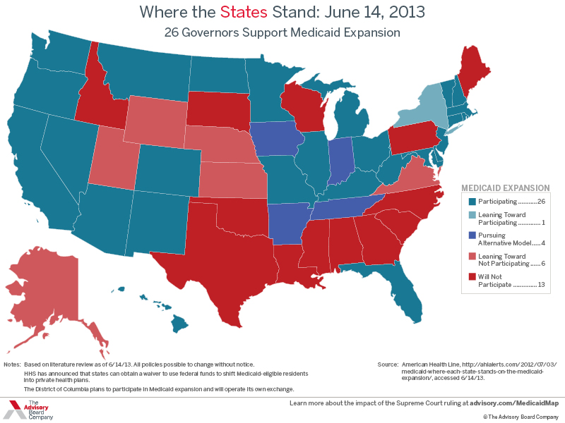

Slide 101

Notes:
Kaiser site, google this

Slide 102


Slide 103
KanCare (Medicaid) Expansion
Proponents:
  More people with insurance, better health
  Offset DSH and Medicare payment cuts to providers
  Economic benefits to state and communities
  “Too good a deal to pass up”
Opponents
  Unaffordable
  Medicaid is a “broken” program
  Federal government won’t meet funding obligations
  Anti-ObamaCare

Slide 104
SCOTUS impact on Medicaid and ACA
ACA does not provide an affordable alternative to Medicaid coverage
  The subsidies are not available for this population to help purchase health insurance in the online marketplaces (less than 100% FPL)
  Special subsidies to documented immigrants who would otherwise be ineligible for Medicaid but pay 2% of income toward policies
  Strange conundrum
This leaving many likely to still be uninsured (6 million)
  The new “donut hole” of health reform
Source: Merrill Goozner, The Fiscal Times; July 24, 2012

Slide 105
How else does ACA affect Medicaid?
Increases primary care provider payments
Gradually reduces disproportionate share hospital payments
Requires a maintenance of eligibility (MOE) compliance that states maintain their eligibility standards in place as of March 23, 2010 until the Secretary of the Department of Health and Human Services (HHS) certifies state’s online marketplace readiness

Slide 106
What are states doing for Medicaid?
All modernizing and streamlining enrollment systems
Almost all participating in “Money follows the person” restructuring of long term care
  Moving from institutional to community-based care
10 states creating “Health Homes” for those with chronic disease or serious mental illnesses
  Comprehensive care management
  Health promotion
  Transitional care

Slide 107
Health Plan Enrollment Eligibility in the Marketplace: Individual
<138% FPL
$15,856
138-400% FPL
$15,856 - $45,960
400% FPL or >
$45,960
State Expansion?
Employer Coverage Adequate and Affordable?
Not Eligible for Tax Credit
Yes
No
Yes
No
Eligible for Medicaid
Eligible for Tax Credit in Marketplace
(100%-138% FPL)
Not Eligible for Tax Credit
Eligible for Tax Credit in Marketplace
FPL = Federal Poverty Level
Consumers can always choose employer coverage if available, or purchase in the private market. To be eligible for tax credits, though, consumers must purchase through the Marketplace.

Slide 108
Health Plan Enrollment Eligibility in the Marketplace: Family of 4
<138% FPL
$32,499
138-400% FPL
$32,499- $94,200
400% FPL or >
$94,200
State Expansion?
Employer Coverage Adequate and Affordable?
Not Eligible for Tax Credit
Yes
No
Yes
No
Eligible for Medicaid
Eligible for Tax Credit in Marketplace
(100%-138% FPL)
Not Eligible for Tax Credit
Eligible for Tax Credit in Marketplace
Consumers can always choose employer coverage if available, or purchase in the private market. To be eligible for tax credits, though, consumers must purchase through the Marketplace.
FPL = Federal Poverty Level

Slide 109
Agricultural worker
Legal authorization to work
Annual income below 138% FPL (app $26,600 family of 3)
Annual income above 138% FPL (app $26,600 family of 3)
No legal authorization to work
Employer supplied insurance
Eligible for Medicaid
Employer supplied insurance (ESI) for large employers when working
Insurance through Exchange if no employer coverage
Forgo insurance; individual pays penalty if affordable insurance is available
Reliant on safety net and emergency Medicaid
Private insurance
Large employer coverage when working
Farmworker Health Coverage under the Affordable Care Act in 2014
Notes:
Joel Diringer, JD, MPH
Diringer and Associates
2475 Johnson Avenue
San Luis Obispo, CA 93401
805-546-0950
joel@diringerassociates.com
www.diringerassociates.com

Slide 110
Farmworker Summary
Farmworkers will continue to face difficulties in securing health coverage and paying for care
The Medicaid expansion will primarily benefit documented individuals (undocs will receive emergency coverage only)
The Large Employer mandate will benefit those full-time workers who work for a single employer for more than 90 days
The Marketplaces will benefit documented individuals with subsidized premiums, but potentially large out of pocket expenses
Some safety net providers will see increased income, while others may become financially unstable
Critical to health reform is immigration reform.

Slide 111
Who gets covered in Kansas?
365,000 Kansans currently uninsured
(13% of population)
Under ACA:
  About one-third remain uninsured
  About two-thirds would receive insurance coverage
    ~60% through expansion of Medicaid
    ~40% through expansion of private insurance
  Without Medicaid expansion only about 26% uninsured Kansans will get covered (96,360)

Slide 112

Notes:
KHI analysis of 2011 and 2012 US Census CPS

Slide 113
ACA Impact in Kansas
Provision | Impact in Kansas
Dependent coverage to age 26 | 25,000+ young adult Kansans covered
No out-of-pocket costs for preventive services | 529,000 Kansans in private plans and 313,000 in Medicare have received no-cost preventive care
Closing the donut hole | In 2012, 23,000 Kansas Medicare beneficiaries received $14 million in Rx discounts, averaging $615 per person
Premium rebates | 67,000+ Kansans with private insurance received more than $4 million in rebates from insurance companies
Early Retiree Reinsurance Program | 60+ Kansas employers participate, including Koch Industries, Sprint, State of Kansas, school districts, BCBS-KS, BCBS-KC
Federal funding | $90 million+ has been awarded to public and private Kansas recipients
Health Reform Resource Project

Slide 114

Notes:
114
To review, here is a chart outlining the new coverage system that will be in place by the end of 2014 when most parts of health care reform take place. As you can see, the most significant changes in coverage involve the insurance Exchanges as well as the new insurance credits.

Slide 115
Estimated Health Insurance Coverage in 2017
Uninsured
Uninsured
Medicaid/CHIP
Medicaid/CHIP
Exchange
Private
Non-Group/Other
Private Non-Group / Other
Employer-sponsored Insurance
Employer-sponsored Insurance
NOTE: This assumes that all states choose to expand Medicaid eligibility up to 138% FPL January 2014.
SOURCE: Congressional Budget Office, February 2013. Total may not equal 100% due to rounding

Slide 116
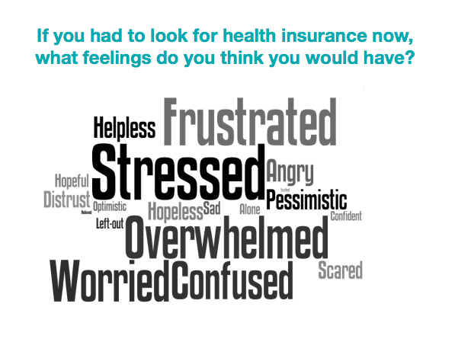

Slide 117
Where do we go from here?
Marketplace opens October 2013
  healthcare.gov
  marketplace.cms.gov
New world of insurance begins Jan 1, 2014
  Individual mandate and employer responsibilities
OUTREACH / EDUCATION / ENROLLMENT

Slide 118





The ACA Streamlines Enrollment Processes, Making it Easier to Obtain Coverage
HEALTH
INSURANCE
$
Data
Hub
Dear ______,
You are
eligible for…
Medicaid
CHIP
Exchange
#
Multiple Ways to Enroll
Single Application
for Multiple Programs
Use of Electronic
Data to Verify Eligibility
Real-Time Eligibility Determinations

Slide 119
Consumer Assistance
Toll-free hotline
Agents/brokers
Navigators
  Community and consumer-focused nonprofits, professional associations, others
  Selected and trained by federal government
  Provide outreach and impartial information

Slide 120
Health Care Reform: Opportunities for Extension
Why should I care about the Affordable Care Act?

Slide 121
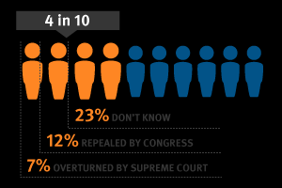
Current Status of Health Care Law
KFF Health Tracking Poll, April 2013

Slide 122
Majority Say They Don’t Understand How ACA Will Impact Them, Including Two-Thirds of Uninsured and Low-Income
Do you feel you have enough information about the health reform law to understand how it will impact you personally, or not?
NOTE: Don’t know/Refused answers not shown.
SOURCE: Kaiser Family Foundation Health Tracking Poll (conducted March 5-10, 2013)

Slide 123
Changes to health insurance make a difference to the communities we serve
Counties are heavily dependent on the government to pay for the health care costs of their residents
  Over 50% of health care dollars spent by government
    Sickest, most needy on public insurance
In rural counties the proportion can easily be over 50% and heavily impacts local hospitals where Medicare is major payer.

Slide 124
Extension’s Role
Even if we don’t agree with any particular policy that has passed, it is the law of the land, and
We can help our community residents navigate the changing health care landscape and the choices they will need to make
  No person will be untouched whether private or publicly insured

Slide 125
Changing Landscape for Whom?
Medicare population
  New preventive benefits
  Reduction in Part D drug gap (donut hole)
  Likely phasing out/reduction in coverage of Advantage Program (managed plans)
  Quality changes by redirection of resources
Low income families
  Currently uninsured insured will be eligible for marketplace
  And may vary year to year so difficult transitions

Slide 126
Changing Landscape for Whom?
Employees
  Those not shifted to Exchanges will see different requirements on their insurance policies (e.g., elimination of pre-existing condition exclusions; no lifetime caps; coverage of adult children)
Businesses
  Get tax credits for offering insurance
  Will have option of paying into Exchanges for their employees

Slide 127
What Does Extension Have to Add to Educational Materials Already Available?
We offer multi-pronged educational programs that reach diverse populations
Value added, deeper understanding of how inter-related the issues impacting health are (think Linda Booth Sweeney’s system approach)

Slide 128
Direct Education Role for Extension Educators
Helping consumers make decisions between plans
Responding to wellness aspects of ACA with direct programming on wellness and health promotion
  Who else will do this? Insurers?
    Lots of online information but is this education? (AARP, Consumer Reports)

Slide 129
Developing Educational Efforts Related to ACA Changes
Design of consumer educational programs concerned with
  Preventive benefits for Medicare beneficiaries
  Medicaid options for low income families
  Exchange options for low and middle income families
  General insurance changes for currently employed population
  General health insurance literacy
  Overview of potential impacts of ACA on communities

Slide 130
How can Extension Educators program around the Affordable Care Act?
Traditional programs
  Special interest educational sessions
  Train-the-trainer, Volunteers
  Health Insurance Fair
  Hands- on experiential session – computer lab- sign up for program
  Fact Sheet
  Media Series – newspaper, television, radio
Newer Traditional programs
  Website content- fact sheets, video training
  Facebook pages
  Blogs
  Twitter

Slide 131
Why Do Educational Programs on ACA?
Extension Perspective
  Local faculty/specialists - pulse on their communities
  Unbiased educational resource – responsive to local needs
  Build community capacity
  Empower individuals and families to make informed decisions
  National issue – potential impact on everyone
-2013 -- Teachable year

Slide 132
Where Does Extension Programming around ACA fit in?
Agriculture/Agri-Business
4-H Youth Development
Family and Consumer Sciences
Community &Economic Development Work

Slide 133
Creating Health: Building
Community Capacity through Partnerships and Collaborations
Comprehensive systems approach to helping individuals, families and communities create health
  County: Health, Human Services, Aging Depts, Health Educators, Aging Benefit Specialists, Special Committees and Coalitions
  State: Dept of Financial Institutions
  Federal Reserve Board: MoneySmart Week
  Community organizations: AARP, Chambers of Commerce, Farm Organizations
  Medical institutions

Slide 134
ACA KSRE Curriculum
Along with professional development workshops specific to KSRE faculty, developing resources for KSRE faculty and other community partners to use:
PowerPoint slides with talking notes
  -Presentations—different audiences, different lengths
  -Train the Trainer
Sub-population specific factsheets
Small group activities
Poster board displays
Press release templates
And more… social media….
Notes:
134

Slide 135
ACA KSRE Curriculum
Using the ACA curriculum being developed KSRE faculty can work with community partners to act as an ACA resource to:
Small Businesses
Farmers
Community Agencies
Providers
Consumers
Notes:
135

Slide 136
Roberta’s blog
https://blogs.ksre.ksu.edu/issuesinhealthreform/

Slide 137
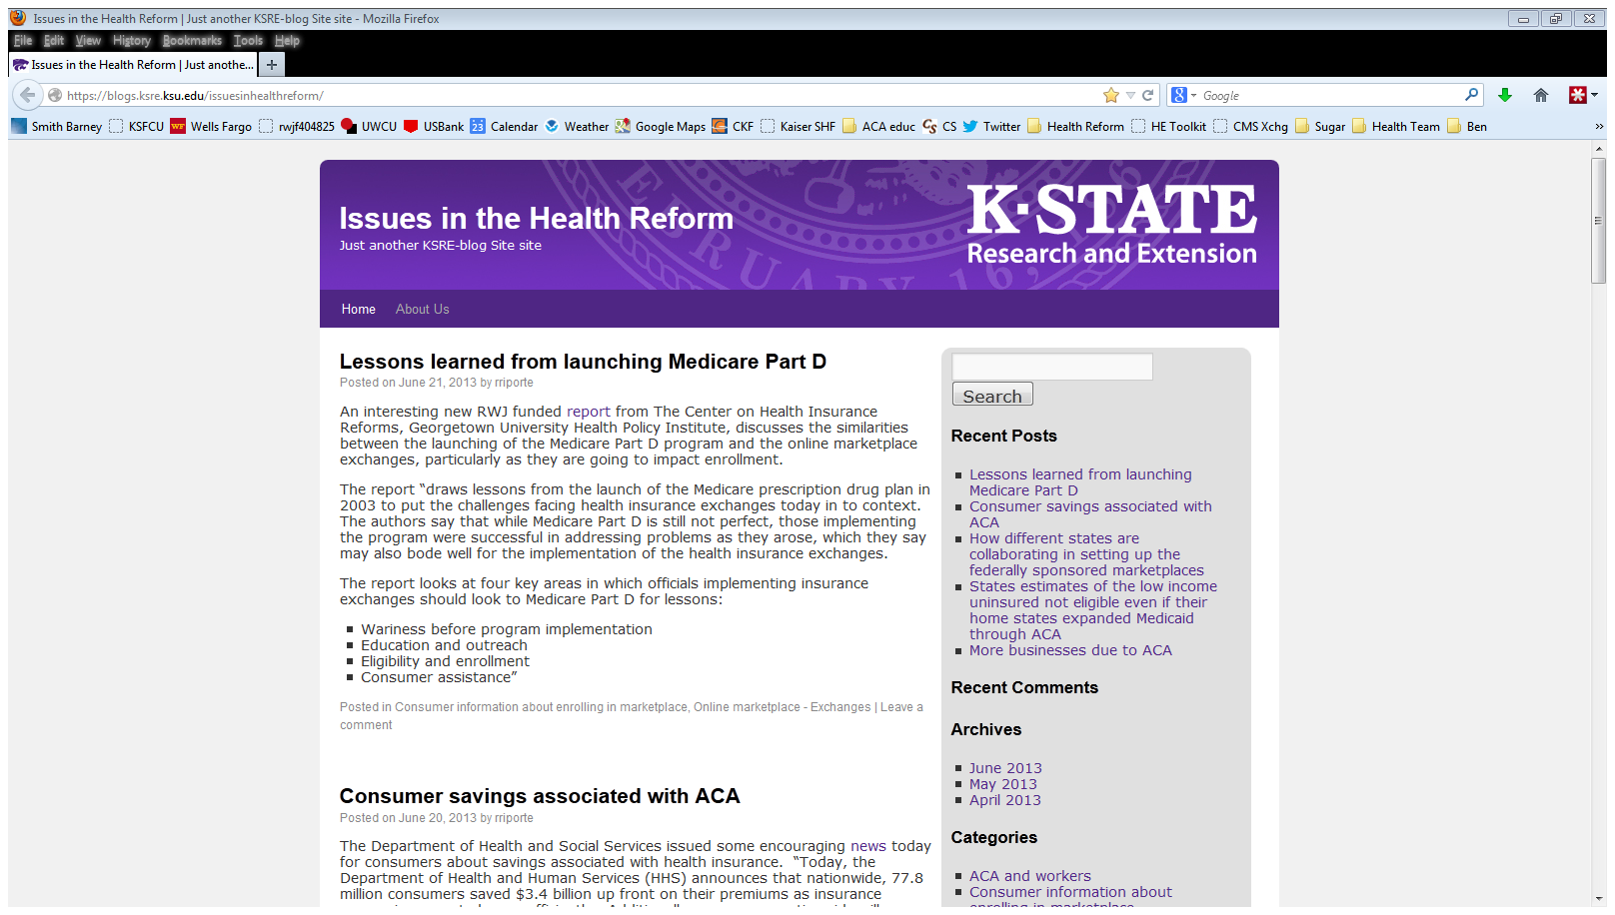

Slide 138
website
http://www.ksre.ksu.edu/issuesinhealthreform/

Slide 139


Slide 140
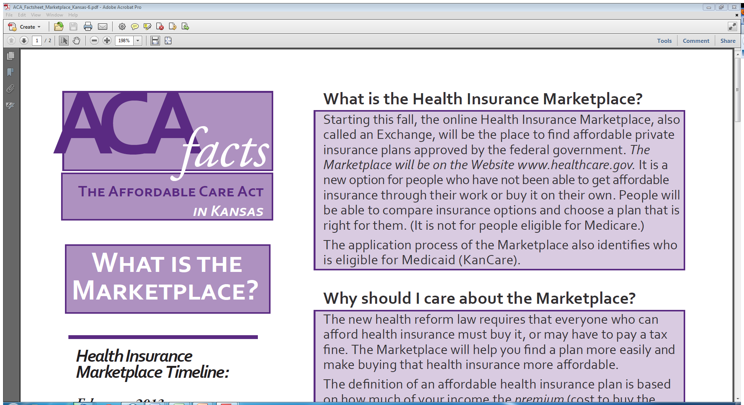

Slide 141
Health Reform Hits Main Street
Henry J. Kaiser Family Foundation Presents
http://www.youtube.com/watch?v=3-Ilc5xK2_E&feature=player_embedded
Easy-to-Use Summary
Kaiser Family Foundation
http://www.kff.org/healthreform/8060.cfm

Slide 142
Kaiser Family Foundation Video
                http://healthreform.kff.org/the-animation.aspx

Slide 143

Robert Wood Johnson Foundation
Present unbiased information about health reform
legislation;
2) Set forth implementation issues;
Help people understand legislation
Help federal and state legislative and public agency
staff, private organizations and interest groups
involved in implementation, health policy
researchers, and the press.
http://www.healthreformgps.org/

Slide 144
Quiz answers
1,4,6,7,9 true
2,3,4,5,8,10 false

Slide 145
Pivotal and Teachable Moment for Community Educators!
Consumers, community leaders, business owners—variable understanding of the ACA, its provisions, and its affects on them
Concerns for costs and benefits
Health Insurance Literacy – Direct Consumer Education
Unbiased educational resource
Building community capacity through partnerships and collaborative efforts
Creating personal and community health
Notes:
Extension has a history of doing public issues education as a neutral party.
The ACA makes preventive care a priority of the nation for the first time in our history. Prevention education is central to Extension education in food and nutrition, safety, pesticide management and other programs. Extension can leverage the emphasis on prevention into programming opportunities to capture attention and interest in existing or new programming.

Slide 146

Questions, Discussion
Notes:
If after reviewing the CKF site and other resources provided, you are looking for additional information or material, please let CKF staff know and we can work to connect you to it or create it for you.
We (do/do not)have time for questions from the audience. Feel free to contact Danielle Zirkel or the CKF ACA team for additional information.
Thank you.

Slide 147

Roberta Riportella, Ph.D.
Kansas Health Foundation Professor of Community Health
K State Research and Extension
Emerita Professor
University of Wisconsin-Madison
343 Justin Hall
Kansas State University
Manhattan, KS 66506
785-532-1942
rriporte@ksu.edu

Slide 148
